Slide 1

Delegation: Asthma Education

Slide 2
Objectives
At the end of our session, you will be able to
  Explain asthma and its characteristics
  Explain how reliever and controller medications work
  Describe and differentiate the three zones of the Asthma Care Plan and Medication Order
  Explain and differentiate the treatment used in the three zones of the Asthma Care Plan and Medication Order
  Demonstrate accurate inhaler technique
  Identify inaccurate inhaler technique

Slide 3
What is asthma

Slide 4
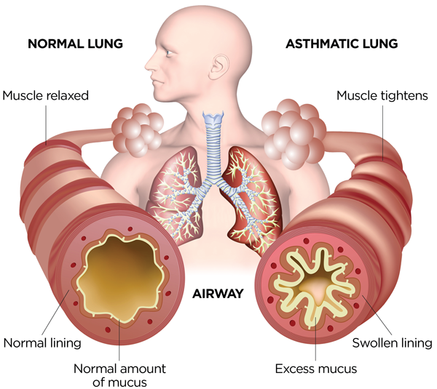
What is asthma?
RECURRENT cough, wheeze, chest tightness, or shortness of breath
REVERSIBLE gets (at least partially) better with a bronchodilator
REACTIVE Symptoms often have specific triggers like exercise or allergies
Notes:
Asthma is a chronic (long-lasting) lung disease. Sometimes people with asthma have symptoms and sometimes they do not. When asthma flares up, it causes the airways in the lungs to become smaller and makes it hard to breathe. Common symptoms include coughing, wheezing, chest tightness and trouble breathing. Asthma affects the airways in 3 ways: 1. Swelling (inflammation) inside of the airway means there is less room for air to get in and out. 2. The muscles around the airways tighten (called bronchospasm). Like swelling, this makes it harder to get air in and out of the lungs. 3. Increased mucus production which often blocks some of the airways. The ways that we diagnose asthma is by taking a history which confirms recurrent cough, wheeze, SOB, that is reversible, gets better with quick relief medication and is reactive or triggered by different things in the environment or respiratory illnesses. We can also do breathing test called spirometry and may also test for allergies.

Slide 5
Recognizing Worsening Asthma
Cough:
With asthma you may cough a lot, even when you don’t have a cold. The cough may last a long time. It may wake you up at night. You may cough when you play or exercise.
Wheezing:
Wheezing is a whistling sound when you breathe out. This is the air trying to go through narrow airways. Out of breath When you feel out of breath you may have trouble breathing or feel like you can’t get enough air. You may need to breathe faster than normal.
Chest tightness:
Chest tightness is when your chest feels tight or heavy. Your chest may hurt or feel like something is squeezing or pressing on it. You may feel like it is hard to get air in and out of your lungs.
Fatigue/tiredness:
Fatigue or tiredness is when you get tired more easily than usual.

Slide 6
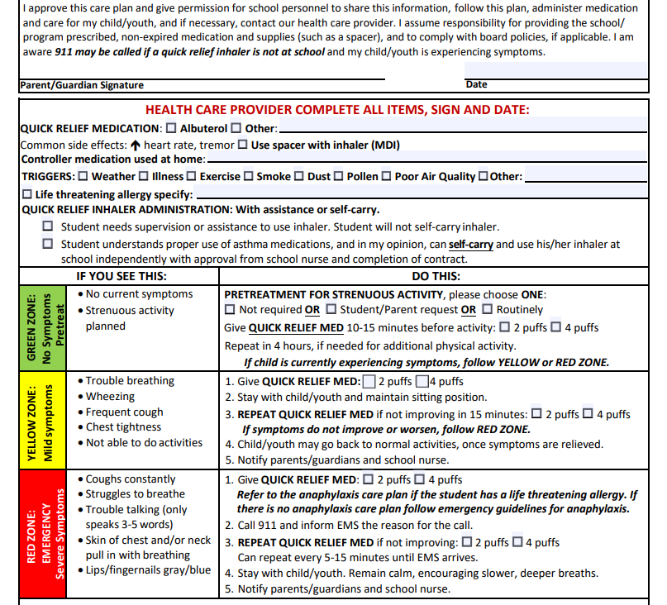

Slide 7

Green Zone: Pre Treat EIA
What to look for:
Child is breathing easy; No symptoms
Energy level is normal

Slide 8
Green Zone: Pre Treat EIA
What to do:
Not required: Reliever not to be administered for physical activity
Student/Parent Request: Administer reliever inhaler 10-15 minutes prior to exercise (recess, gym class), if student/parent requests
  Students may only need to pre treat when experiencing a cold or bad allergy season or for more vigorous/strenuous activity, like fun mile run

Slide 9
Green Zone: Pre Treat EIA
What to do:
Routinely: Administer reliever inhaler before gym class and recess
Reliever lasts 4 hrs; so if given for morning recess at 0800 and then had gym class at 2pm, need to repeat use of inhaler
If gym and recess occur within 4 hours of administration of reliever, there is no need to repeat

Slide 10

Yellow Zone: Worsening Asthma
What to look for:
Child is having a hard time catching breath-trouble breathing
Experiencing asthma symptoms:
  Coughing
  Wheezing
  Chest feels tight
  Tiredness
Unable/not wanting to do activities

Slide 11
Yellow Zone: Worsening Asthma
What to do:
Administer reliever inhaler (2 or 4 puffs)
Remain with student
If student not feeling better (decrease symptoms, still trouble breathing), repeat administration of reliever inhaler (2 or 4 puffs)
  After this round of reliever administration and not feeling better, follow red zone and call 911
Once student feels better/good/back to self, may return to activities
Notify parents/guardians that child had trouble breathing and that reliever was used

Slide 12

Red Zone: Danger
What to look for:
Constant coughing
Struggling to breathe
Wheezing
Trouble speaking- only ale to speak few words before needing to take another breath
Lips/fingernails are gray/blue

Slide 13
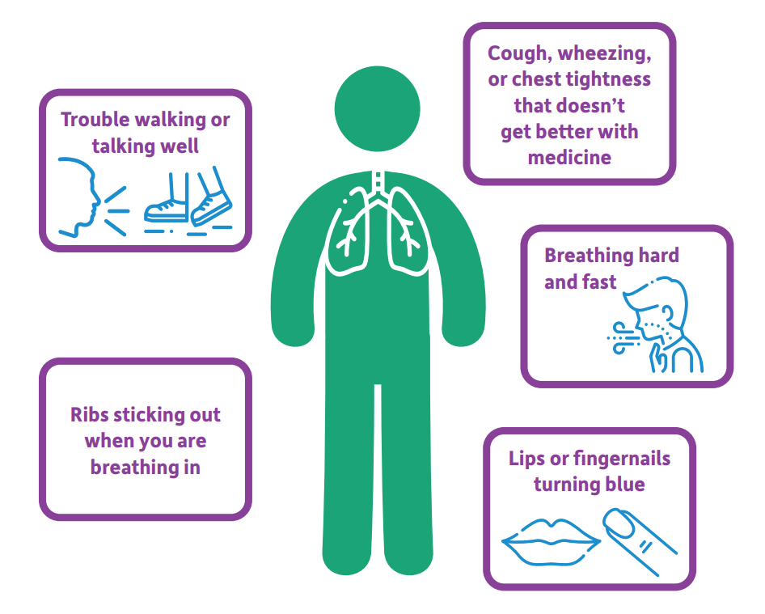
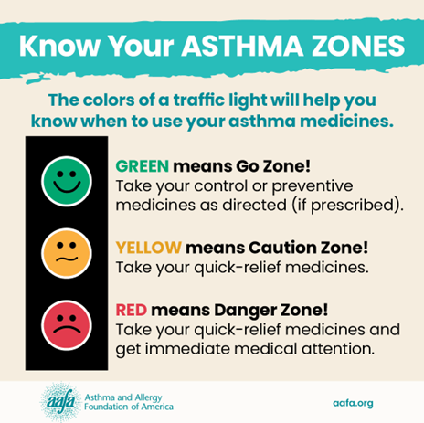
TAKE ACTION! Know the zones and act accordingly, follow the care plan!

Slide 14
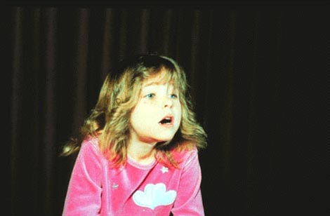
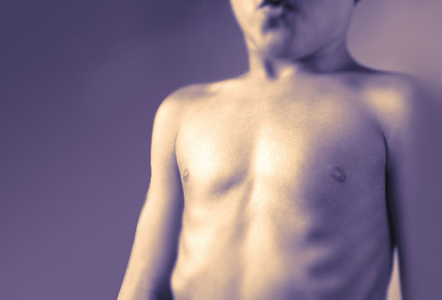
Physical signs of asthma worsening
Anxious, leaning forward, and nasal flaring
Retractions – Inward movement of the muscles in the neck, chest or ribs.
Notes:
Physical signs to be aware of include anxious appearing child, they may have nasal flaring, increased working of breathing with pulling in of the muscles in the neck, chest and ribs. Blueness around the lips and fingernail beds indicate hypoxia (low oxygen). These are are all emergency signs. Follow Redd Zone treatment plan or school emergency plan.

Slide 15
Red Zone: Danger
What to do:
Give quick relief inhaler (2 or 4 puffs, as specified)
  If student has life threatening allergy, follow student’ anaphylactic plan. If doesn’t have plan, follow emergency guidelines for anaphylaxis
Call 9-1-1 and inform EMS of reason for call
Repeat quick relief inhaler administration, if not improving (2 or 4 puffs, as specified)
  Can be repeated every 5-15 minutes to treat ongoing/continuous symptoms until EMS arrives
Remain calm and with child, encourage slower and deeper breaths
Notify parents/guardians

Slide 16
Types of Medication:
Relievers and Controllers

Slide 17
Reliever/Rescue Medication
Students with active asthma should have a reliever inhaler at school
  In past year, experienced asthma symptoms and used an inhaler
Come as inhalers or liquid for a nebulizer treatment; you may need more than one
Works by relaxing muscles around the airways (that cause airway narrowing/bronchoconstriction) which opens-up the airways making it easier to breathe/relieving symptoms
Quick relief medication typically starts working within a few minutes.

Slide 18
Reliever/Rescue Medication
When used?
  Relieve/reverse asthma symptoms- treat a flare-up
  Pre-treatment prior to exercise/strenuous activity to prevent asthma symptoms from developing

Slide 19
Controllers
Most effective medication for controlling asthma and preventing asthma attacks
  Reduce airway inflammation/swelling and mucus production
Usually taken every day (at home)
May take up to 4 weeks to be fully effective and to lose its effectiveness
Controllers often contain corticosteroids
  Some are biologics that are not a steroid
Often an inhaler with a combination of medications that include an inhaled steroid and a long-acting bronchodilator

Slide 20
Controllers
Examples of inhaled steroids
  Beclomethasone (QVAR)
  Budesonide (Pulmicort)
  Fluticasone (Arnuity)
  Mometasone (Asmanex)
Combination inhaler examples:
  Budesonide/Formoterol (Symbicort)
  Fluticasone/Salmeterol (WIXELA INHUB)
  Mometasone/Formoterol (Dulera)

Slide 21
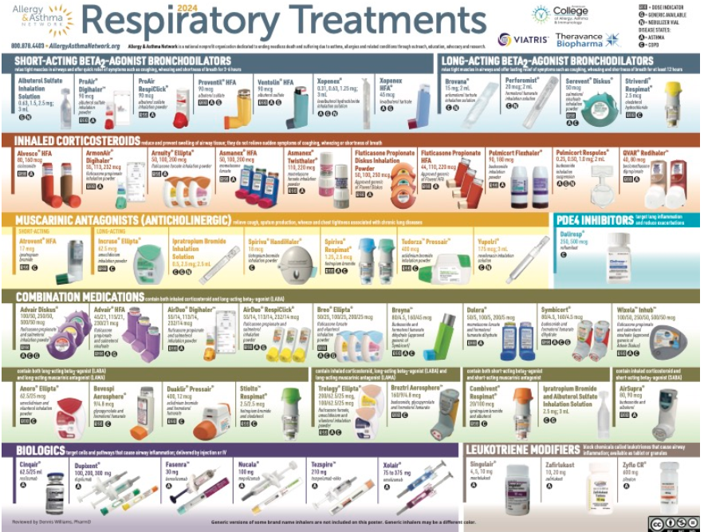

Slide 22
Inhaler Technique

Slide 23
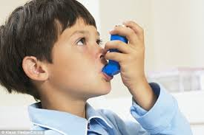
HOW TO USE AN INHALER
Remove cap
Shake vigorously
Normal exhalation
Slow Inspiration
  Place in mouth place
  Start a slow inhalation
  Depress canister once during start (first quarter) of inspiration and continue to inspire/breathe in (about 5 seconds)
Hold breath for 10 seconds and exhale

Slide 24
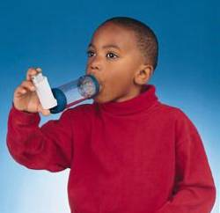
HOW TO USE MDI INHALER WITH SPACER
Prepare device: Remove caps, shake inhaler, insert inhaler into spacer.
Breathe out normally and place mouthpiece between teeth with close lips around it. (Opening should not be blocked by tongue.)
Spray one puff into the spacer by pressing down on the inhaler.
Breathe in slowly and deeply.
If you hear a whistle, breathing is too fast.
5) Hold breath for count of 10 and exhale.

Slide 25
Students who can’t hold breath or breathe in slowly: Using MDI inhaler with spacer
Prepare device: Remove caps, shake inhaler, insert inhaler into spacer.
Place mouthpiece between teeth with close lips around it. (Opening should not be blocked by tongue.)
Breathe normally/slowly in and out of spacer.
After an exhalation, spray one puff into the spacer by pressing down on the inhaler.
Complete 5-6 complete breath cycles.
6) Repeat steps: Shake inhaler, insert spacer in mouth, start tidal breathing, spray one puff into spacer, complete 5-6 breath cycles

Slide 26
Let’s Practice

Slide 27
Putting it all together

Slide 28
Case: Emilia
Comes to see you after recess with coughing and states, “I’m not feeling well.”
You observe that she is breathing a bit more quickly, and you can hear wheezing as she speaks. She is speaking in full sentences
What Zone is she in and the reasons?
What are your next steps?

Slide 29
Case: Rudy
Rudy has a cold and missed the last two days of school.
He comes to your office and explains that he doesn’t feel well and that he is having trouble getting a breath. He asks to use his inhaler to help him breath.
You give him his inhaler and note that his technique was good when he used the spacer with the MDI. He took 2 doses.
He stays in your office because he is still not feeling better.
10 minutes has passed and he says, “My inhaler really hasn’t helped”. He is coughing and wheezing and his respiratory rate is 32. You observe that he is working to breathe- he is tripoding
What do you do?

Slide 30
Case: Rudy
He takes 2 more doses of his reliever inhaler with spacer. Technique was good.
You note he is getting a bit anxious/nervous. His respiratory rate is 40 breaths per minute.
He lets you know that he is not feeling better and explains his inhaler always works. He is still coughing and wheezing a raises his shoulders when breathing in.
What is the zone and what do you do?

