Slide 1


Reducing Asthma Attacks in Disadvantaged School Children with Asthma
www.coloradokidswithasthma.org
Notes:
PRA - try a different picture for CAB - And keep the same for SAB – done

Slide 2
Agenda
Notes:
Please refer to you program packet for a detailed schedule and objectives. Over the next 2 hours, we will share experiences and build on basic asthma knowledge and skills. Thank you for taking time today to participate in this asthma workshop.
Upon successful completion of this course, you will receive a certificate of participation. You will also receive a gift certificate as a token of our appreciation for your time.

Slide 3
Learning Objectives
At the end of this session, you should be able to:
To understand asthma and identify common asthma triggers
To be able to recognize signs & symptoms of worsening asthma
To feel confident in managing worsening asthma episodes

Slide 4

Group Agreements
Respect others and opinions
Share at your comfort level
Active participation

Slide 5

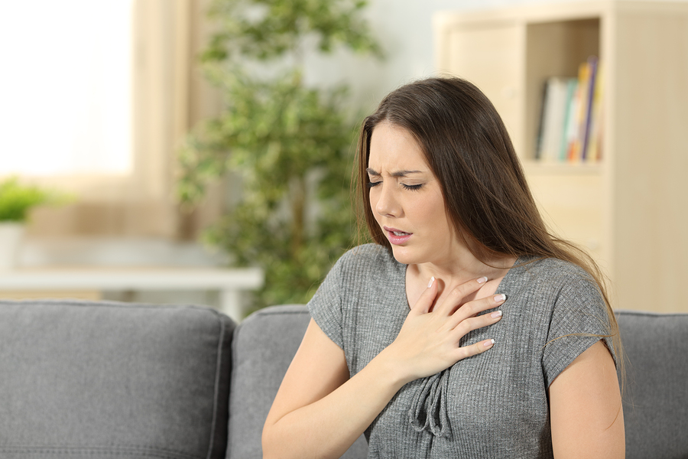


Warm-up
A day in the life of a student with asthma
Fatigued
Can’t breathe/ panicky
Breathless
Stressed
Notes:
Before we get started, lets take a moment and reflect on what it may feel like for a person who is experiencing asthma. Please share what you think it is like for a person living with asthma. How might you feel? How might it impact your activities?

Slide 6

Program Impact
Fewer missed school days
Improved asthma self-care skills
Reduced activity limitations
Improved rates of asthma control
Reduced frequency of ED visits and hospitalizations
Meeting student’s asthma goals – sleep, learn and play!

Slide 7
ASTHMA BASICS

Slide 8
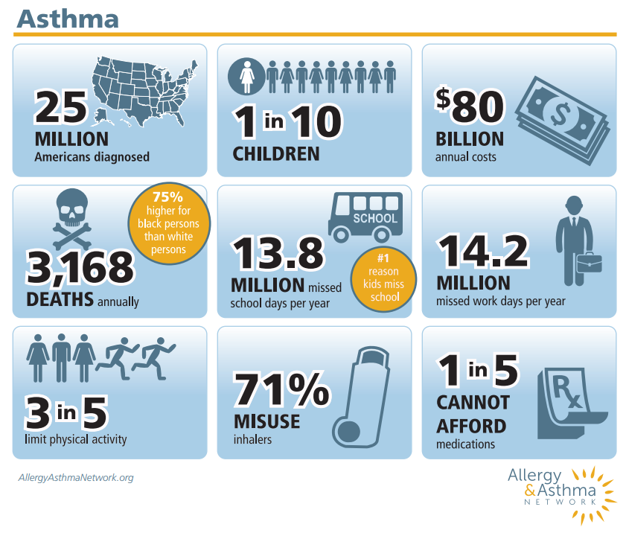
Why asthma matters
A leading cause of hospitalization and missed school days
Economic Burden
Asthma disparities due to structural, social, genetic and behavioral factors

Slide 9
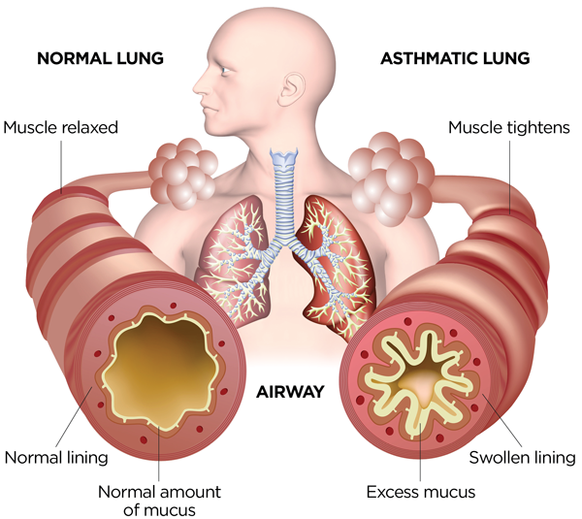
What is asthma?
RECURRENT cough, wheeze, chest tightness, or shortness of breath
REVERSIBLE gets (at least partially) better with a bronchodilator
REACTIVE Symptoms often have specific triggers like exercise, illness or allergies
Notes:
Asthma is a chronic (long-lasting) lung disease. Sometimes people with asthma have symptoms and sometimes they do not. When asthma flares up, it causes the airways in the lungs to become smaller and makes it hard to breathe. Common symptoms include coughing, wheezing, chest tightness and trouble breathing. Asthma affects the airways in 3 ways: 1. Swelling (inflammation) inside of the airway means there is less room for air to get in and out. 2. The muscles around the airways tighten (called bronchospasm). Like swelling, this makes it harder to get air in and out of the lungs. 3. Increased mucus production which often blocks some of the airways. The ways that we diagnose asthma is by taking a history which confirms recurrent cough, wheeze, SOB, that is reversible, gets better with quick relief medication and is reactive or triggered by different things in the environment or respiratory illnesses. We can also do breathing test called spirometry and may also test for allergies.

Slide 10
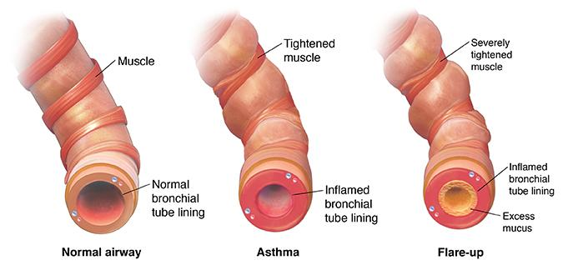
What happens in asthma?
Accessed by: http://www.munsonhealthcare.org/Taxonomy/RelatedDocuments.aspx?id=0&sid=1&ContentTypeId=3&ContentID=84608

Slide 11
ASTHMA TRIGGERS
Notes:
People with asthma have extra sensitive lungs. When they are exposed to something called an asthma trigger, in their environment their lungs react.
Asthma triggers are unique to each child/individual as not everyone reacts to the same thing.
The important thing is to reduce or minimize exposure to known triggers.
Can anyone tell me what some common asthma triggers are?

Slide 12


Illness
Respiratory infections increase airway inflammation, mucous production and airway hyperresponsiveness (twitchiness)
Strategies to prevent illnesses
Practice good hand washing
Get annual flu shots
Keep hands away from your face
Notes:
Increased inflammation and mucous production exacerbate asthma symptoms
Get annual flu shots
Practice good hand hygiene
No sharing water bottles

Slide 13

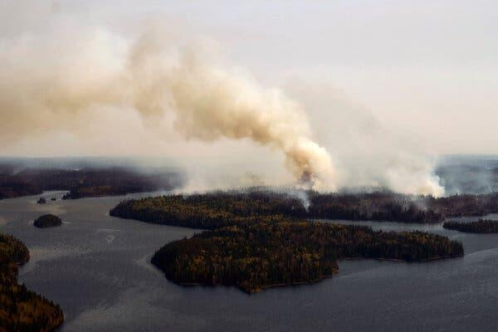
Common allergens
Pollen
Mold
Dust Mites
Cockroaches/Rodents
Animal Dander
Common irritants
Smoke (including wildfires)
Cold air
Strong smells (diffusers)
Cleaning products
Vaping
Chemicals

Slide 14

Physical activity: All students need to be physically active
One of the most common triggers
Breathing dry cold air may lead to bronchospasm
Symptoms may occur during or after exercise
Avoidance of exercise is not a solution

Slide 15
ASTHMA MEDICATIONS
Notes:
The goal of asthma management is to control symptoms, prevent risk of asthma exacerbations, and maintain normal or near normal lung function. Well controlled asthma leads to fewer missed school days and improved quality of life for kids who have asthma.

Slide 16
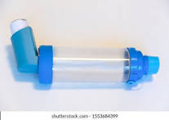
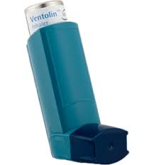
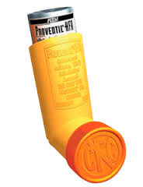

ASTHMA MEDICATIONS
Relievers relax tight muscles in airways
Work quickly (within minutes)
Every student with asthma should have one easily accessible at school
Taken before exercise if indicated
Examples: albuterol, Ventolin, Proventil, ProAir

Slide 17
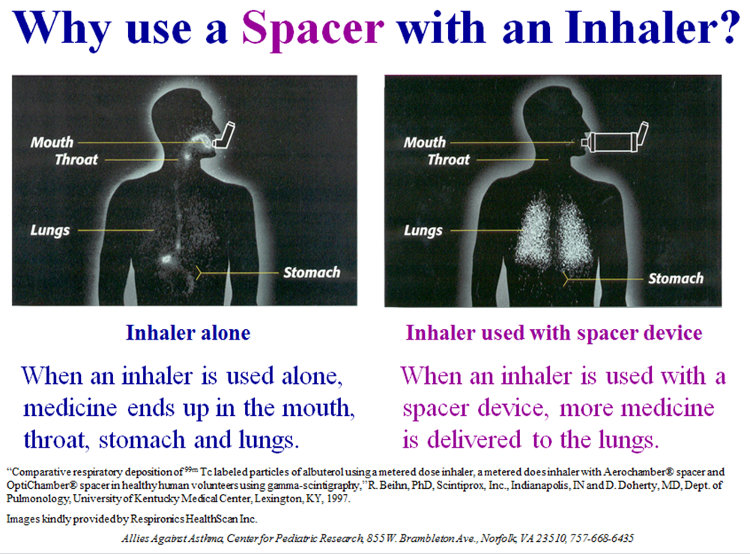

Slide 18
WHAT SHOULD WE EXPECT FOR ASTHMA?

Slide 19

Expect ASTHMA CONTROL CRITERIA:
Asthma symptoms less than 3 days week
Sleeping through the night
Needing the Reliever Inhaler less than 3 days week
Normal Activity level with no interruptions
*Can use reliever 1X/day for exercise without being included in count

Slide 20
MANAGING WORSENING ASTHMA

Slide 21

Green Zone- Pre-Treatment for Physical Activity (common asthma trigger)
Look for:
No symptoms
(How ordered: Not required, upon request, routine)
DO this:
Send to health office if that is location of inhaler
Provide doses/puffs of reliever inhaler (ideally with spacer)
Warm-up and cool down important with sustained physical activity

Slide 22
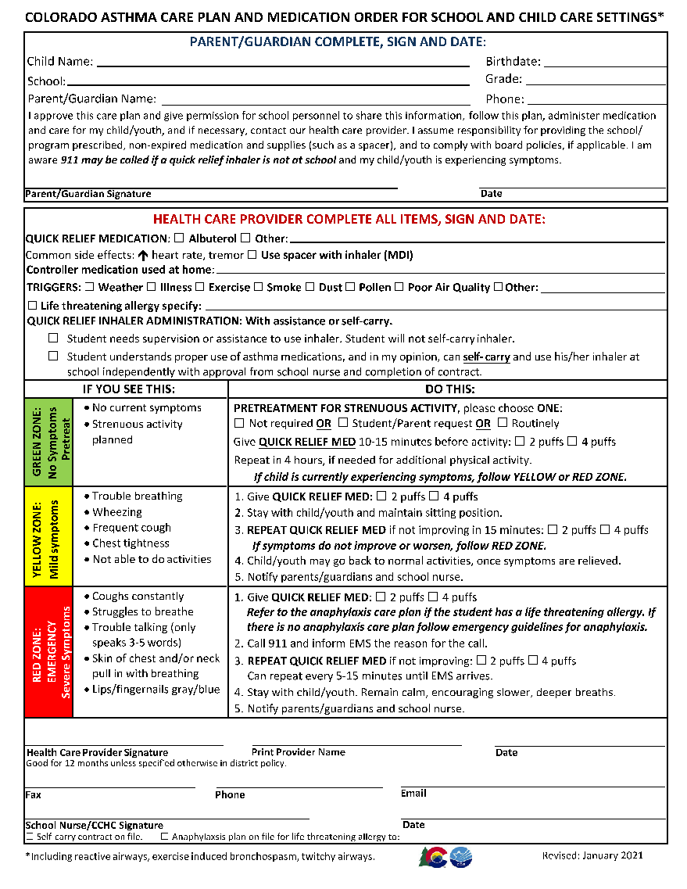

Colorado Asthma Care Plan and Medication Order
Notes:
Provider completes annually
Allows for the administration of inhaler at school with or without supervision (self-carry)
Directs how the inhaler should be used and under what conditions
HIPAA and FERPA release - allows people in school community to communicate
Increase rates by including it in back-to-school asthma packets and at time of school registration

Slide 23
Recognize asthma worsening and take action!
Early warning signs:
Coughing
Wheezing
Shortness of breath
Feeling tired
Changes in mood
Headache
Trouble sleeping
Signs of severe asthma
Difficulty breathing while walking or talking
Inward movement of the muscles in the neck, chest or ribs (retractions), or flaring of the nostrils
Notes:
Early warning signs may include:

Slide 24
Yellow Zone: Warning, Take Action
Look for:
DO this:
Trouble breathing
Coughing, frequently
Wheezing
Not able to do activities
Give reliever inhaler (2 or 4 puffs)
  Get nurse, aide , inhaler plus spacer
Relief typically felt in 5-10 minutes
If relieved of all symptoms, can return to activities
If not feeling better, repeat doses of reliever inhaler
Stay with student
Evaluate response, if not improving move to Red Zone, call 911

Slide 25
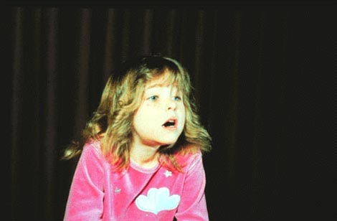

Physical signs of asthma worsening
Anxious, leaning forward, and nasal flaring
Retractions – Inward movement of the muscles in the neck, chest or ribs.
Notes:
Physical signs to be aware of include anxious appearing child, they may have nasal flaring, increased working of breathing with pulling in of the muscles in the neck, chest and ribs. Blueness around the lips and fingernail beds indicate hypoxia (low oxygen). These are are all emergency signs. Follow Redd Zone treatment plan or school emergency plan.

Slide 26
Red Zone: Danger, Medical Attention
Look for:
DO this:
Coughing constantly
Working/struggling to breathe
Can’t speak in full sentences –only speaks a few words and then needs a breath
Lips and/or fingernails turn a bluish color
Incomplete relief from inhaler
Give reliever inhaler (2 or 4 puffs)
  Get nurse, aide , inhaler plus spacer
Call 911, explain reason for call- asthma
Stay calm and remain with student
Encourage taking slower and deeper breaths
If not improving can repeat, giving reliever inhaler every 5-15 minutes until EMS arrives
Notify parents/family

Slide 27

Communication
Make sure you know the following information:
What symptoms are present during worsening asthma/attack for this student
Where is the reliever inhaler
What triggers the student’s asthma
When to contact school nurse/aide and parent/family

