Slide 1

Asthma Navigator Training
Day 3
June 15, 2023

Slide 2
Agenda
7:30-8:00 Team Building
8:00-10:00 Working in School Settings
10:00-10:30 Optimizing Behavior Change
10:30-10:45 Break
10:45-11:45 Inhaler teaching session
11:45-12:15 Adverse Events training
12:15-12:45 Working in Healthcare Settings
12:45-1:15 Lunch
1:15-1:45 Case Management and Care Coordination
1:45-2:15 Playbook
2:15-2:30 Next Steps

Slide 3
Team Building
7:30-8:00

Slide 4
Nostalgic Photo
Thank you everyone for sending me a nostalgic photo!
We are going to go through each on and you can tell us a story or something related to the photo

Slide 5
Working in School Settings
8:00-10:00

Slide 6
The Foundation has been laid
You have already received the “Baseball Cards” for all your schools. This document lays out the basic demographics of your school and their current practices related to asthma and social determinants of health
  Please review these in depth
Schools and their nurses know about the program and are excited to get your help
You will start by helping with in person school registration and back to school events

Slide 7




GOAL: Students in school and ready to learn
but asthma can
cause absenteeism, about 13 million days/year
decrease academic performance
limit student participation in classroom activities, physical education, and school events

Slide 8
Identifying Students with Asthma: Asthma Intake Form
Should be completed for each student with asthma annually
Schools we are working with have agreed to use the AIF although it might not be part of their normal work flow already
Tools for assessing asthma
  Asthma control
  Triggers
  Asthma medications
  Burden
Indicates asthma risk for experiencing excess asthma burden
Assists in prioritizing level of care needed to support student
We use this form to determine student eligibility

Slide 9
School forms related to asthma: CO Dept Education
Asthma Intake Form
Colorado Asthma Care Plan and Medication Order for Schools and Child Care Settings

Slide 10
Asthma Intake Form

Slide 11
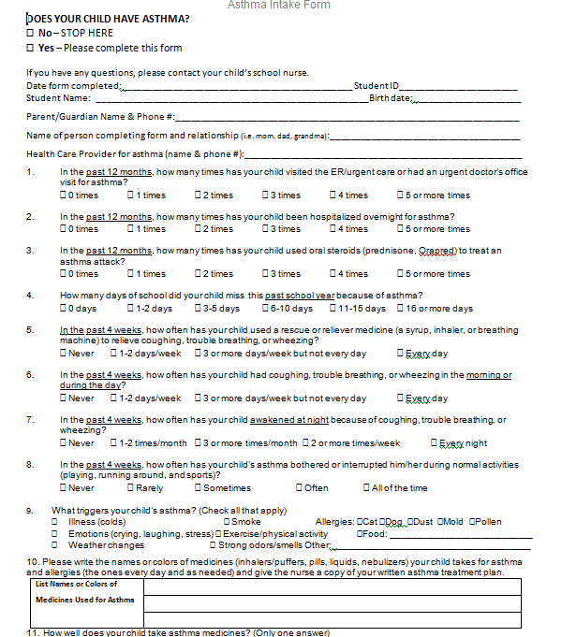
Asthma Intake Form

Slide 12
Asthma Intake Form
Should be completed for each student with asthma annually
Tool for assessing asthma
  Asthma control
  Triggers
  Asthma medications
  Burden
Indicates asthma risk for experiencing excess asthma burden
Assists in prioritizing level of care needed to support student

Slide 13
Asthma Control
Asthma control criteria based on
  Night-time awakenings
  Experience of symptoms
  Use of quick relief inhaler (beta₂ agonist bronchodilator)
  Activity level

Slide 14
Asthma Control
Asthma control criteria based on
  Night-time awakenings
  Experience of symptoms
  Use of quick relief inhaler (beta₂ agonist bronchodilator)
  Activity level

Slide 15
Uncontrolled Asthma
Cut points for uncontrolled asthma (one or more of the following)
  Nighttime asthma awakening >2 times per month
  Daytime asthma symptoms >2 days per week
  Rescue/quick relief medication >2 days per week
    If use for pre treat before exercise, it doesn’t count it’s a freebie
  Limiting activity due to asthma ‘often’ or ‘all of the time’

Slide 16
At-Risk for Unnecessary Asthma Burden
At-risk factors indicating closer monitoring and intervention- our eligibility criteria
  Indicators of impairment during the last year
    2 or more urgent care/ED visits for asthma
    Any hospitalization for asthma
    2 or more courses of prednisone or systemic corticosteroids for asthma
    >5 missed school days due to asthma in the previous school year
  Current uncontrolled asthma
All information contained on AIF

Slide 17
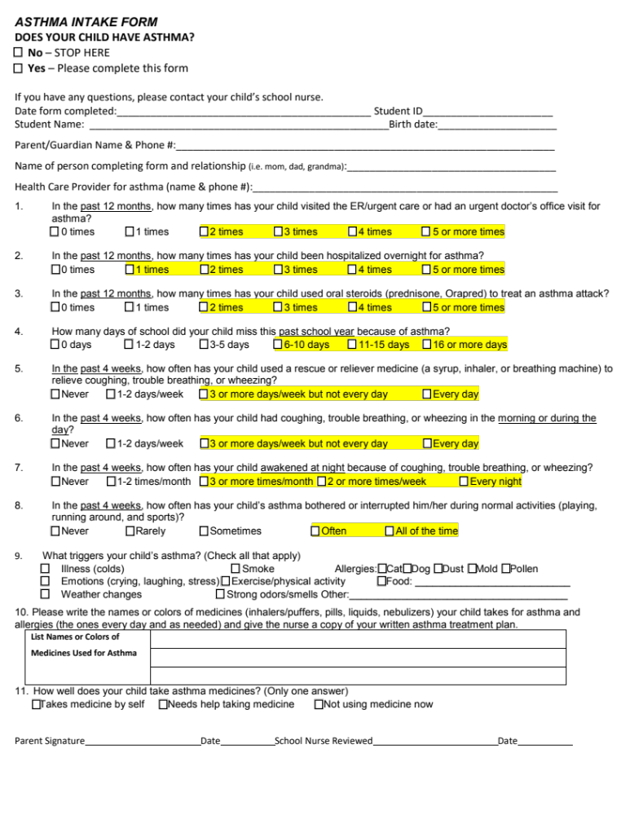
Asthma Intake Form
Your cheat sheet

Slide 18
Prioritizing and Triaging
No/Lowest priority: Inactive asthma (no asthma symptoms or asthma meds used in the last 3 yrs.)
Normal priority: Active asthma that is under control with no at-risk factors
Moderate priority: Current uncontrolled asthma or other at-risk factors indicating previous impairment
Highest priority: Current poorly controlled asthma PLUS additional at-risk factors indicating previous impairment

Slide 19
Benefits of Completed Asthma Intake Forms
Permits triaging and prioritizing the work of school nurses
Identifies who needs completed CO Asthma Care Plan and Medication Order plus accompanying inhaler at school
Identifies who needs to be monitored more and most closely
Also identifies who, ideally, needs follow-up
  Contact with parents/guardians re: poorly controlled asthma
  Contact with health provider
  Visit with student to re-assess

Slide 20

Let’s Practice
Cases Pulling it Together

Slide 21
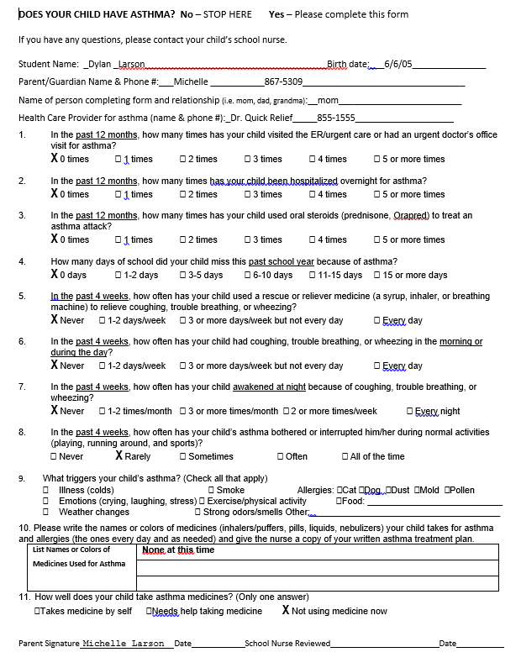

Slide 22
Asthma Intake Form Review
Dylan
  Interpretation: Inactive asthma
  Triage/Priority level: No/lowest priority level
  Next steps: None
  Asthma status can always change

Slide 23
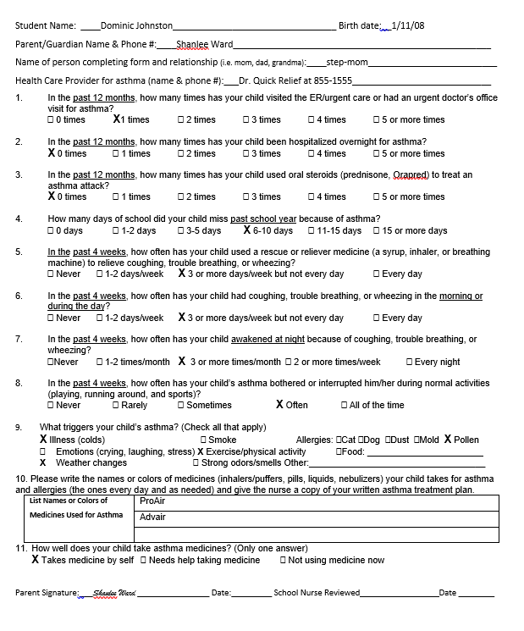

Slide 24
Asthma Intake Form Review
Dominic
  Interpretation: Active asthma
    Evidence
      Current use of asthma medication and symptoms
  Triage/Priority level: Moderate priority level
    Evidence
      Poorly controlled asthma: day and night-time symptom frequency
      1 emergency department visit in past year and some missed school
  Next steps:
    Follow-up with family for fuller assessment and education
    Advise to follow up with MD/DO/NP/PA to regain asthma control
    Closer monitoring
    Completed Colorado School Asthma Care Plan
    Ensure easy access to quick relief inhaler
    Assess and coach for accurate inhaler technique
    Assess student’s self management skills and ability to implement/follow Colorado School Asthma Care Plan

Slide 25
CO Asthma Care Plan and Medication Order
Completed annually
Allows for the administration of inhaler at school with or without supervision (self-carry)
Directs how the inhaler should be used and under what conditions
HIPAA- Health Insurance Portability and Accountability Act release
FERPA- Family Educational Rights and Privacy Act- HIPAA for schools –allows people in school community to communicate about student
You will not be able to fully support completion of this form as we don’t have the appropriate agreements from schools and parents/guardians
  Can’t call/contact providers
May be part of the asthma packets you help assemble

Slide 26
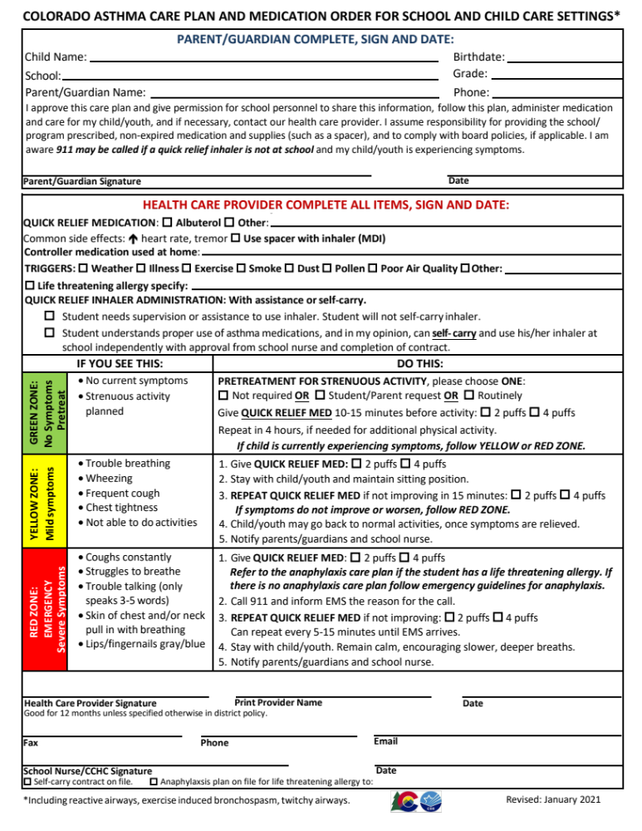
CO Asthma Care Plan and Medication Order

Slide 27
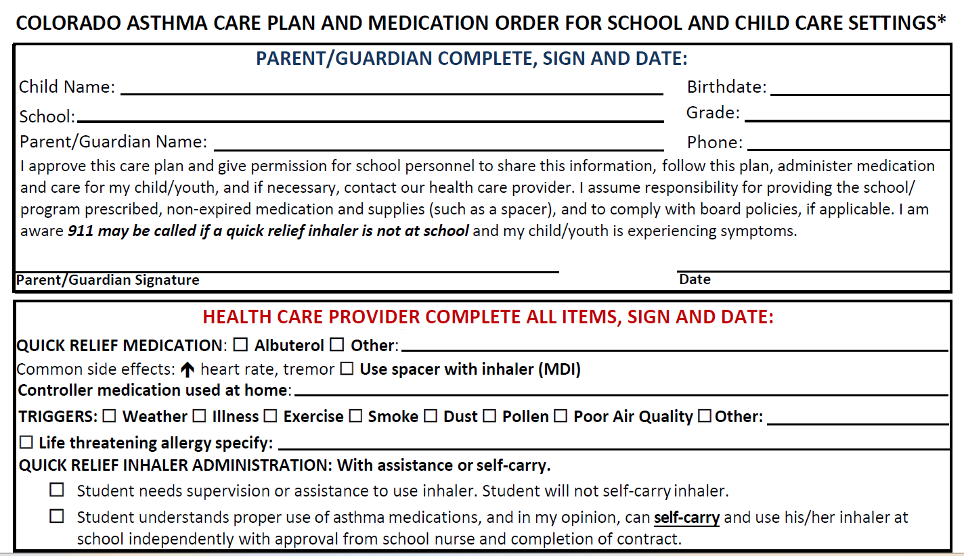
Colorado Asthma Care Plan and Medication Order for School and Child Care Settings
Student information – make sure it is complete
Triggers/Allergies – identifies specific triggers
What to do if no quick relief is available – contact parent/call 911 if student is in distress

Slide 28
Preventing Exercise Induced Asthma
Warm-up and cool-down periods to help prevent or lessen episodes of exercise-induced asthma
Alternate
Run/walk rather than a full distance run
Incorporate
Less intense aerobic activities (walking, some field events, weight training)
Give
Pre-treatment, if ordered
Increase

Slide 29
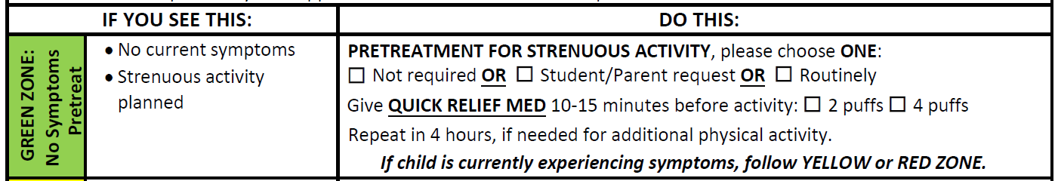
Green Zone Goal - prevent EIA symptoms
Green zone – student not experiencing symptoms
Action – pretreatment to facilitate physical activity
  Who does it apply to?
  All of the time versus occasionally
    As needed:
      recovering from illness,
      allergy season
      cold weather
      specific types of physical activity (mile run)

Slide 30
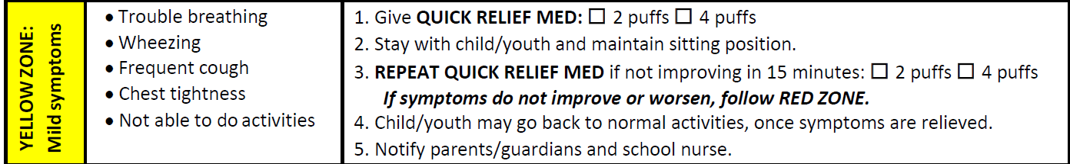
Yellow Zone Goal – Provide quick relief
Yellow Zone- student experiencing signs and symptoms of asthma worsening.
  Acute loss of control may be due to a variety of reasons: viral/infectious, allergic, non allergic, irritants
Action – prompt recognition worsening asthma (coughing, wheezing, trouble breathing , chest tightness)
Assess severity, provide quick relief, and reassess
Do not leave child unattended, maintain sitting position
Determine next steps based on response

Slide 31
Responding to an Asthma Episode
Stop the student’s current activity and remove trigger
Keep student in upright position
Help student to remain calm
Provide quick relief medication, if not available get help
Help student use quick relief medication; observe for effect
Follow the school asthma care plan
Never leave student alone

Slide 32
Yellow Zone - Making the most of each encounter with student
Teachable moment - Opportunity to teach self-monitoring and self-management skills
Identify trigger – teach how to avoid or manage trigger to prevent further symptoms
Assess proper self management skills including inhaler technique
Ask about medications taken at home, reinforce adherence with controller medications

Slide 33
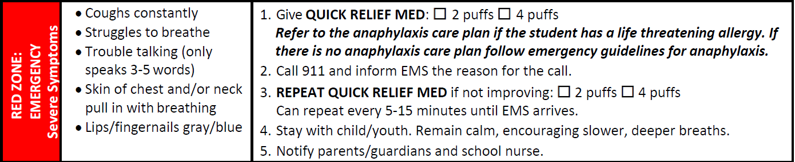
Red Zone Goal – Immediate Medical Attention
Red Zone – student experiencing severe flare up/attack
Action:
  Prompt recognition of severity (struggles to breath, retractions, trouble speaking, cyanosis, decreased LOC)
  Provide quick relief medication, close and continuous monitoring
  Call 911

Slide 34
Get Emergency Help
Student fails to improve.
Any of the following symptoms are present:
struggling to breath (retractions, hunched shoulders and increased work of breathing)
difficulty completing a sentence without pausing for breath
lips or fingernails turn blue
Always follow your school’s policies and procedures.

Slide 35
Red Zone – Medical Emergency
Children can decompensate quickly
Never leave a child with asthma symptoms unattended
Increased risk of fatality if:
Frequent exacerbations, previous intubation, overuse of rescue medication, co-existing medical conditions including food allergies.
However even a student with mild asthma can have a life-threatening attack

Slide 36
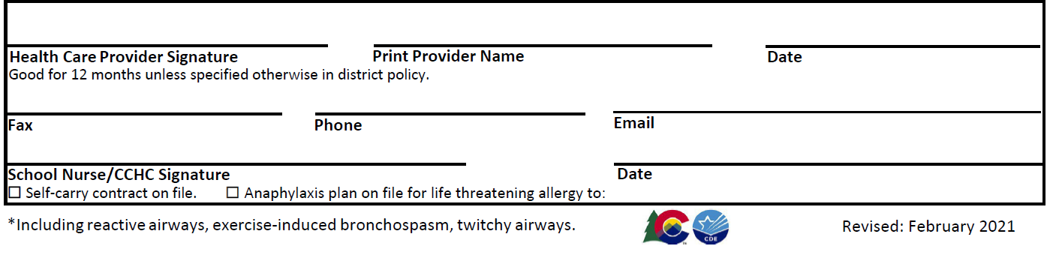
Self-carry and Coordination of Care
Health care provider may recommend self-carry but decision to allow a student to self carry is the school nurse’s assessment of readiness /self care skills and parent agreement.
Need for bi-directional communication on student’s asthma and questions regarding the care plan
Provide copies of plan to appropriate school personnel

Slide 37
Checklist for implementing Colorado School Asthma Care Plan
Ensure plan is current and filled out completely
Ensure quick relief medication is accessible at school and check expiration date and doses remaining
Meet with parent and child to understand child’s needs and build rapport
Review and take necessary steps to implement plan (prevent exposure to triggers and schedule for pretreatment)
Communicate with pertinent school staff, i.e. teachers, PE instructors, recess attendants
Contact parent and HCP if the plan is not working
Update the plan as needed
Send copies of plan with medication on field trips

Slide 38
Building Relationships with School Communities
Schools are a trusted entity in the community and must do all they can to maintain public trust and protect the rights and privacy of students (FERPA).
They will want to know more about you and your purpose for working with the school: Who, what, when, how, where and for how long?
The Planning for Partnering Guide helps you to track these important tasks.

Slide 39
Building and Maintaining Trust
Getting to know you – what is the best way to communicate?
Security clearance – may require background check/security badges
School culture: dress codes, communication, checking in
Data sharing and Confidentiality Agreements – agreement with school regarding use of data and privacy protection language
Research review and approval – does school have a research review committee? If yes, how often do they meet? When is the next meeting?

Slide 40
Security Checks, Ethics, Confidentiality, FERPA, HIPAA and self-study
Security checks- schools often require security checks before you can work in schools
Confidentiality Agreements: To protect private information of students, families and school personnel
HIPAA: ??
FERPA: ??
Ethics: Puts all of the above together. Colorado Multiple Institutional Review Board (COMIRB) has training modules that lay out best practices and regulatory requirements

Slide 41
HIPAA vs FERPA
Family Educational Rights and Privacy Act (20 U.S.C. § 1232g; 34 CFR Part 99)
Since 1976
Federal Oversight
Health Insurance Portability and Accountability Act of 1996, Public Law 104-191
Fully enacted 2003
Federal Oversight
Notes:
Privacy Rules-Privacy Rule – Establishes privacy requirements for oral, written or electronic individually identifiable health care information. Compliance Date - April 13th, 2003. The HIPAA Privacy Rule excludes from its provisions all education records covered by the Family Educational Right and Privacy Act (20USC 1232g), including individually identifiable student health information.
Security Rule – Establishes security requirements for electronic health care information. Compliance Date - April 21, 2005
Ref-http://www.nasn.org/ToolsResources/DocumentationinSchoolHealth/HIPAAandFERPA

Slide 42
HIPAA vs. FERPA
Protects Individually Identifiable Health Information(PHI)
Covered Entities: Health Care Providers, Health Care Plans, for example
School-based programs could be covered entities if billing Medicaid Services ie- SBHC
Protects student education records/data(PII)
Entities: Public & Private Schools who accept Federal funds
Student records include health information, school nurse notes*, special education records
Parents/Students have Rights to request review and amendment of records and the right to privacy of PII

Slide 43
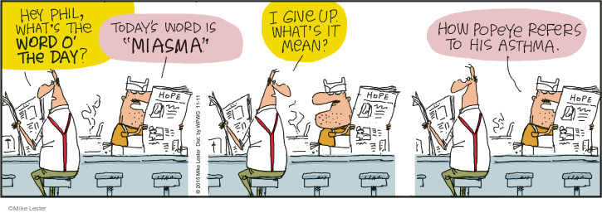
Questions?

Slide 44
Optimizing Behavior Change
10:00-10:30

Slide 45

Optimizing Behavior Change
8:15-8:45

Slide 46
Objectives
At the end of this session, you should be able to:
  Apply principles of effective education
  Explain importance of tailoring
  Explain stages of change
  Explain motivational interviewing
  Apply motivational interviewing skills

Slide 47
Asthma Self-Management Education
Education Process
  Assessment- allows for tailoring
  Planning
  Implementation
  Evaluation

Slide 48
Tailoring
Tailoring education consists of adapting the intervention to family’s needs with the expectation that this individualization will improve the results of the intervention. Communication is the basis for any individualization process.

Slide 49
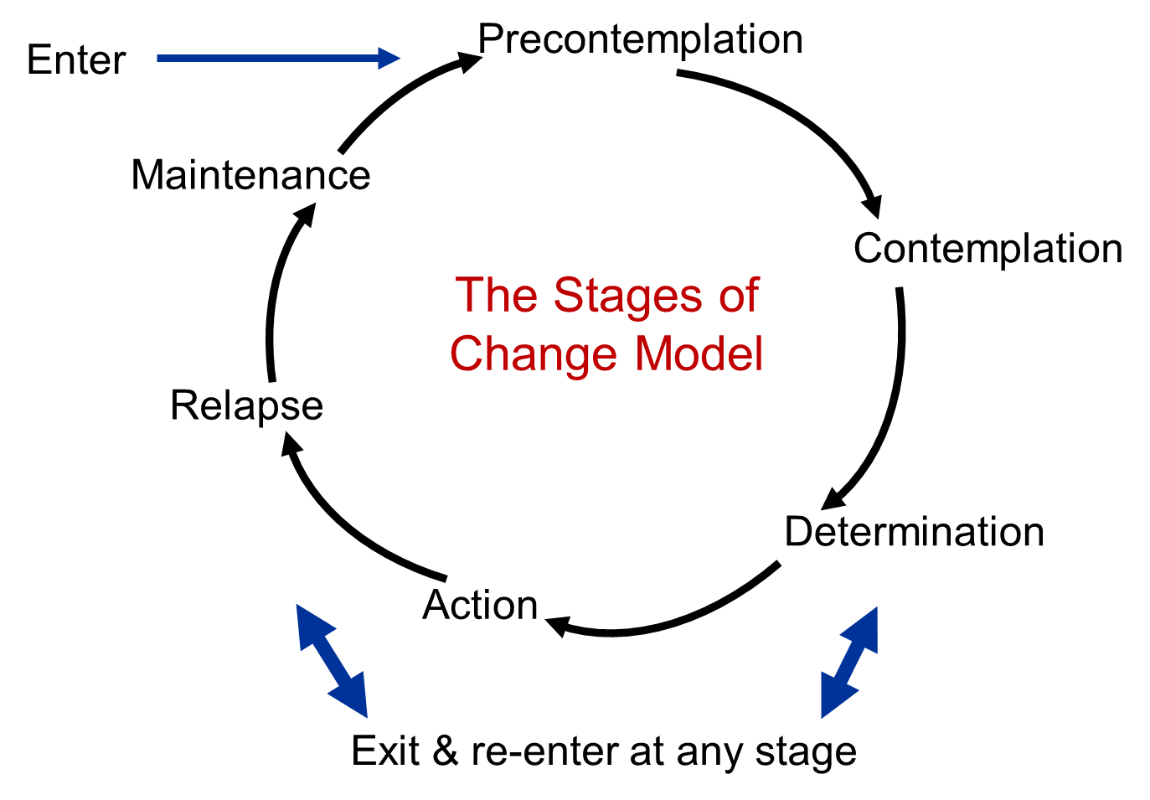
Transtheoretical Model: Stages of Change

Slide 50
6 Stages of Change
Precontemplation - People do not intend to take action in the foreseeable future (defined as within the next 6 months). People are often unaware that their behavior is problematic or produces negative consequences. People in this stage often underestimate the pros of changing behavior and place too much emphasis on the cons of changing behavior.
Contemplation - People are intending to start the healthy behavior in the foreseeable future (defined as within the next 6 months). People recognize that their behavior may be problematic, and a more thoughtful and practical consideration of the pros and cons of changing the behavior takes place. Even with this recognition, people may still feel ambivalent toward changing their behavior.
Preparation (Determination) - People are ready to take action within the next 30 days. Take small steps toward the behavior change and believe changing their behavior can lead to a healthier life.
Action - People have recently changed their behavior (defined as within the last 6 months) and intend to keep moving forward with that behavior change. Exhibit by modifying their problem behavior or acquiring new healthy behaviors.
Maintenance - Sustain their behavior change for a while (defined as more than 6 months) and intend to maintain the behavior. Work to prevent relapse to earlier stages.

Slide 51
Motivational Interviewing
MI is a guiding style of communication, sits between good listening and directing (giving information and advice)
Designed to empower people to change by drawing out their own meaning, importance and capacity for change
Based on respectful and curious way of being with people that facilitates the natural process of change and honors autonomy
MI requires engagement as an equal partner and refrains from unsolicited advice, confronting, ordering, warning

Slide 52
Motivational Interviewing: Spirit
Partnership. Collaborative process. People are the experts of their own lives.
Evocation. People have within themselves the ability to change.
Acceptance. Takes a non-judgmental approach, seeking to understand person’s perspectives and experiences, expresses empathy, respects persons right to make informed choices about changing or not.
Compassion. Promotes and prioritizes welfare and well-being in a selfless manner.

Slide 53
Motivational Interviewing
Express
Express empathy (through reflective listening)
Develop
Develop discrepancy (between the individual's goals and their current behavior). Avoid argumentation.
Roll
Roll with resistance (acknowledge and explore the individual's resistance to change, rather than opposing it)
Support
Support self-efficacy.

Slide 54
Motivational Interviewing: OARS
Open questions.
Affirmation.
Reflection.
Summarizing.
*Exchange of information respects that both A Navigator and family have expertise. Sharing information is considered a two-way street and needs to be responsive to what familyis saying.

Slide 55
Motivational Interviewing: Fundamental Processes
Engaging: Foundation of MI. Establish a productive working relationship through careful listening to understand and accurately reflect the person’s experience and perspective while affirming strengths and supporting autonomy.
Focusing: Agenda is negotiated that draws on both the family and Asthma Navigator’s expertise to agree on a shared purpose, which gives the Asthma Navigator to move into a directional conversation about change.
Evoking: Gently explores and helps the person to build their own “why” of change through eliciting their ideas and motivations. Ambivalence is normalized, explored without judgement. This process requires skillful attention to the person’s talk about change.
Planning: Planning explores the “how” of change. Develop a plan based on the person’s own insights and expertise.

Slide 56
Behavior Change Strategies
Feedback
Persuasion (credible source, health consequences)
Incentives
(outcome you are achieving)
Training and demonstrating behavior
Modeling
Goal setting behavior: agreeing on goal to be achieved
Monitoring
Social support/encouragement
Shaping knowledge
Natural consequences (Anticipate the outcomes)
Comparison of behaviour
Associations
Repetition

Slide 57
Summary
Assess: Ask questions to identify goals, priorities, understanding, current situation
Based on assessment, tailor education
Understand, acknowledge and recognize 6 stages of change
Respect the spirit of Motivational Interviewing
Use motivational interviewing to tailor intervention and planning to achieve goal
Apply a variety of behavior change strategies

Slide 58
Break
10:30-10:45

Slide 59
Inhaler Teaching Session
11:15-12:15
How to teach and assess inhaler technique for students and family
Demonstrate in pairs with each other

Slide 60

What Does a Teaching Session Include?
Let’s Practice

Slide 61
Teaching Session with Patients
Request student to demonstrate their inhaler technique:
  “Can you show me how you use your….?”
Observe technique and provide feedback and coaching to patient:
  Identify/review steps performed correctly.
  Identify/review steps performed incorrectly.
Demonstrate technique if patient’s technique was very poor and or they are not understanding directions.
Ask for a repeat demonstration.

Slide 62
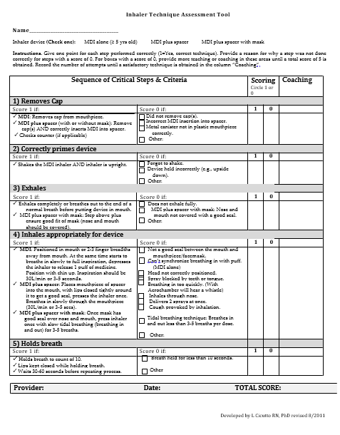
Inhaler Technique Assessment Tool
Allows a simple and consistent scoring of inhaler technique
Based on 5 key steps
Identifies correct technique and common errors

Slide 63
Role Play: In Pairs
Each person will play role of patient and clinic team member for MDI alone.
First pair scenario:
  Student: Prescribed reliever (albuterol) MDI\and reports will not likely use spacer).
  Health team member/nurse:
    Explain steps and demonstrate MDI technique
    Use Inhaler Technique Assessment Tool to record correct and incorrect steps.
Rotate-Second pair scenario:
  Health team member/nurse:
    Ask patient to demonstrate use
    Identify errors and coach for accurate technique
  Student:
    Demonstrate MDI technique

Slide 64
Adverse Events and Reporting
10:45-11:15

Slide 65
What are adverse events
In research studies, you have to track and report if anything happens to study participants
In this case, we are looking for ED visits, urgent care visits, and hospitalizations
  It is tracked in REDCap in the Baseline Navigator Questionnaire, Follow up Navigator Questionnaire, and Data Collector Instrument and automatically notifies the team
  If any of your student’s has any of these, please also send an email to Rachel to notify us in case the automatic notification glitches

Slide 66
Mandatory Reporting
Since you are working with families, you might be told about neglect, abuse, or domestic violence
As Asthma Navigators, you are not technically mandatory reporters. However, it is important to take these things seriously. You may be a mandatory reporter because of a different position that you hold
If you hear about any child abuse or neglect, please notify a school nurse
If you are a mandatory reporter due to another position, then you must report it immediately. Then, follow up with the school nurse
  If you don’t hear back from the school nurse in 48 hours, call the reporting number on your own 844-CO-4-Kids

Slide 67
Working in Healthcare Settings
12:15-12:45
HCP Communication templates
Expectations for collaboration
Asthma Action Plans

Slide 68

Circle of Support
Providers are often the missing link in SBAPs
BACK will help facilitate provider engagement through coordinated strategies
Asthma Care Plans provide a line of communication.
Providers value contextual information about asthma related experiences in the school setting.

Slide 69
Asthma Navigators role in Bridging Communication Gaps
Foster personal relationships among parents, PCPs and school nurses
  Identify point of contact in the healthcare setting
  Provide information about the program and agreed upon expectations
  Determine preferred method of contact
  Encourage bi-directional communication
Facilitate completion and transmission of the School Asthma Care Plan
  Problem solve around barriers to form completion
  Advocate for extra quick relief medication Rx and spacer for use at school
Be an ambassador for the program and advocate for the student!

Slide 70
HCP Communication Templates
Initial Letter
  Sent upon enrollment
  Purpose - Briefly describes the program and informs provider that their patient is a participating in BACK.
  Shares asthma assessment and information from the SDOH screener
  Checklist of components needed to support asthma management at school
  Response section – allows provider to efficiently communicate back to the program
  Copy shared with family for transparency and to maintain trust

Slide 71
HCP Communication Templates
Reminder Checklist:
  Sent as a reminder if needed
  Checklist of components needed to support asthma management at school
  Response section – allows provider to efficiently communicate back to the program
Follow up Visit and End of Year Letter
  Upon completion of Visit 2 and Visit 3 (final visit)
  Summarizes pertinent findings at the visit including contextual information about asthma experiences at school and self care skills, and barriers to asthma control
  Response section – allows provider to efficiently communicate back to the program

Slide 72
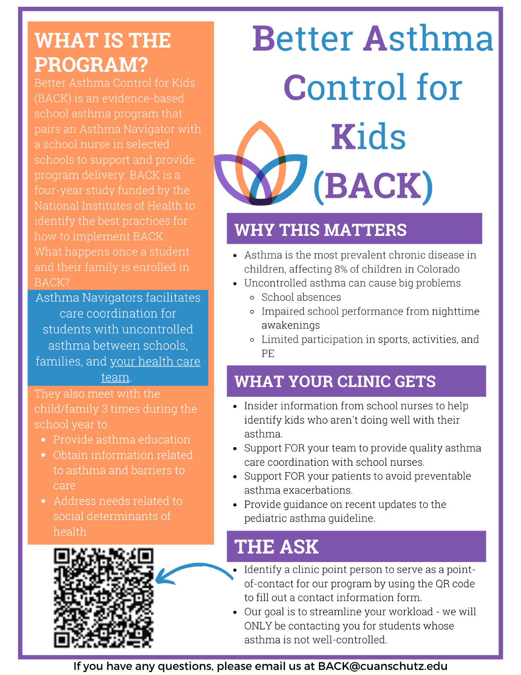
Plan for Partnering
Communication shared with healthcare providers prior to start of the study
Gives clear expectations of the partnership
- What we will do
- What we need you to do
Plan for Partnering Letter can be found in your binder

Slide 73
Clear
Role Delineation
Ultimate responsibility/oversight of child’s asthma management. Primary conduit of communication with PCP and School.
Role of Primary Care Provider
Diagnosis, treatment plan, initiating asthma education, proactive with forms.
Role of School Nurses
Reinforcing asthma self management education, monitoring, managing and referring parents to PCP if needed.
Challenge
Time and lack of staff training as barriers to communication.
Role of Parents/Caregivers

Slide 74
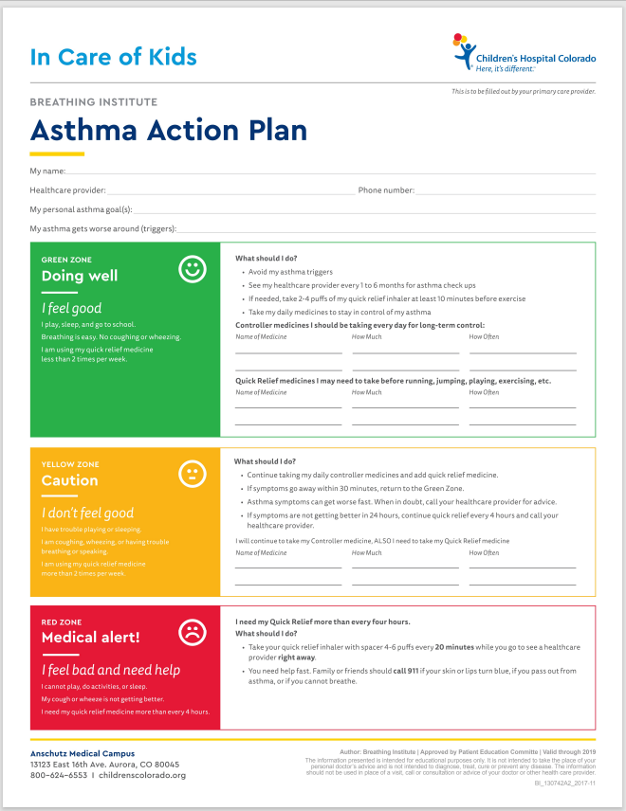
Asthma
Action
Plans

Slide 75
Frequency of School Nurses Contacting Students’ HCP to Support Asthma Care for Students (n=9)
Notes:
This is data from a school nurse survey that demonstrates the challenge school nurses have with obtaining a school asthma care plan.

Slide 76
Not sure
Ways for accessing form:
Parent/family brings it to me (29%)
Provided by my health care organization apart from the electronic medical record (21%)
CDE website (13%)
School nurse faxes or emails the form to me/clinic (24%)
Embedded in electronic medical record (13%)
Don’t know (0%)
No
Yes

Slide 77
Strategies to Increase Asthma Care Plans and Quick Relief Inhalers at School
1. Identify potential barriers/pitfalls
  Access to forms?
  Questions on how to complete forms?
  Who needs a form?
  How often do you have to complete the forms
  Do all schools accept the standardized Colorado School Asthma Care Plan?
  Is it ok for my nurse to sign the forms?

Slide 78
Strategies to Increase Asthma Care Plans and Quick Relief Inhalers at School
2. Partner with the designated point person to address barriers
  Access to fillable forms on-line or paper copies
  Integrate forms into electronic healthcare system
  Identify the importance of having a school asthma care plan
    Staffing of school nurses; UAPs cover health office, keeps kids in school; reduce inappropriate 911 calls
  Review components of the care plan that are completed by the provider
  Advocate for prescribing 2 inhalers, 1 for home and 1 for school

Slide 79
Strategies to Increase Asthma Care Plans and Quick Relief Inhalers at School
3. Encourage providers to be proactive
  When seeing a child with asthma they should say: “You are going to need an asthma care plan and quick relief inhaler for use at school. We can complete it together and you can sign and return to the school”
  Shared decision making - Do you need to take a pretreatment prior to activities to prevent symptoms?

Slide 80



Circle of Support/Goal - communication and engagement of the child’s asthma team
Not this… more like this… the answer!
Photos by Unknown Author are licensed under CC BY
Notes:
So what have we learned?
All agree that there are barriers to communication.
Efficient, effective communication is a must.
Key is to develop relationships, meet needs, demonstrate benefits. Child-centered care!

Slide 81
Lunch
12:45-1:15

Slide 82
Care Coordination and Case Management
1:15-1:45

Slide 83


Starting Activity
In three words or less, how would you describe Care Coordination?
https://www.menti.com/alrxhnmpfn35
Notes:
Put in chat: https://www.menti.com/alrxhnmpfn35,
Let’s take a moment to think about what we already know about Care Coordination. Use the QR code or the link in the chat to share in 3 words or less, how you would describe or define Care Coordination? What does it mean to you?
-Deliberate organization
-Care activities
-Sharing of information
-Safer and more effective Care

Slide 84
What is Care Coordination?
Definition 1 ..the oversight and alignment of multiple evidence-based components and interventions that support the health and well-being of students with chronic health conditions.
National Association of School Nurses
Definition 2 ..Deliberately organizing patient care activities. Sharing information among all pertinent members of the healthcare team (includes family, school nurse, healthcare providers). Goal – to achieve safer and more effective care.
                Agency for Healthcare Research and Quality
Notes:
AHRQ emphasizes that care coordination necessitates communicating the patient’s needs and preferences at the right time to the right people.

Slide 85

Care Coordination in the school setting
Asthma navigators will help support care coordination and case management for participants in the BACK program.

Slide 86
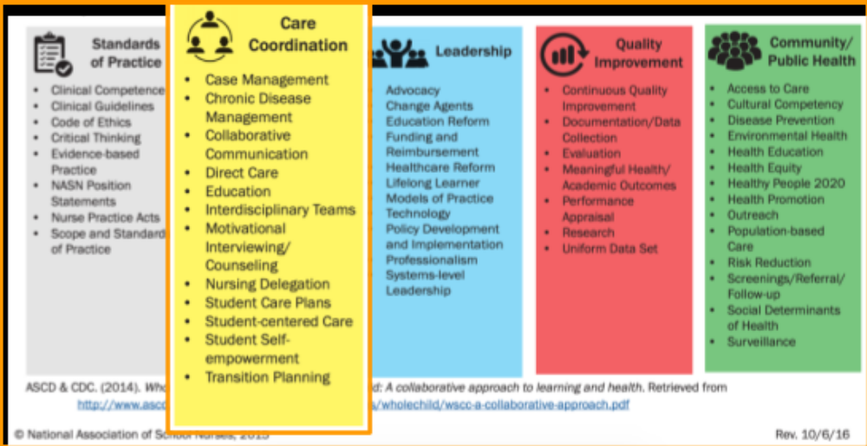
Care Coordination

Slide 87
Which of these Care Coordination Steps may be Performed by an Asthma Navigator?
Delegate Medication Administration to Staff
Meet with Student
Receive CO Asthma HCP/Order
Ongoing Communication with Staff, Parent, Provider
Student Needs Inhaler
Input into Information System
Contact Parent
Receive Medication at School
Inform Staff Who Need to Know
Notes:
Delegation is NOT a role of asthma navigators. Only school nurses can delegate medication administration to school staff.
It is also the school nurses’ role to receive the Asthma Care Plan and Medication and verify completeness and appropriateness.
Asthma Navigators should support the student and SN by helping obtain the school care plan and medication via communication with family and or HCP.
If you are meeting with a student and are concerned that they need to take their quick relief medication, follow the school’s policy and escort student to the health office notifying a responsible staff member that the child is having asthma symptoms and may need their quick relief medication.
Finally, it is the SN’s role to inform school staff who need to know.
Work with your school nurse to support their role while following school policies,

Slide 88
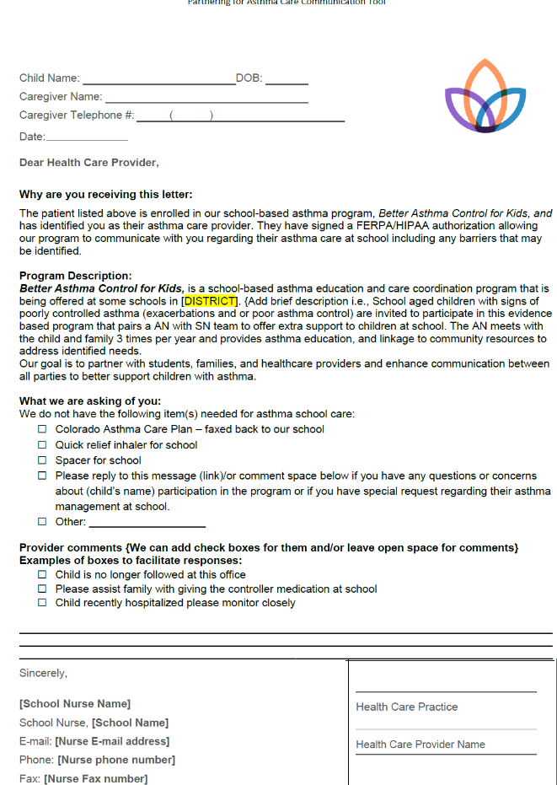
Care Coordination Tools
Communication templates
Initial and follow-up letters to healthcare provider
  Includes “provider next steps” to facilitate care:
    Please send updated Colorado School Asthma Care Plan
    Quick relief medication needed for school
    Referral to agency for SDoH needs

Slide 89
Coordination of Care Activity
Scenario #1
You are assisting with back to school registration. On review of a student’s health history screening, you see that asthma is checked, but no further information is given. What are the next Care Coordination steps you will take?
Scenario #2
During an asthma education visit with a student, you learn they have been waking up due to asthma multiple times per week. They did not take quick relief medication because they were “afraid to wake their parents”. What are the next Care Coordination steps you will take?
Notes:
Let practice now with a few scenarios. We will first have sometime for individual processing and then we will have the opportunity to work in small groups.
In your workbook you have a section with these scenarios written out and then a place to take notes. Remember the order in which you apply these steps for asthma care coordination is not important as long as you use all of the steps. You need to find the best order that you would collaborate the care for each student. To save you some time, you can write the corresponding letter next to the number in the order you would do them in. I’ll read the scenarios now:
Scenario #1 p. 5
You have a new student attending your school. On review of their health history screening, you see that Asthma is checked, but no further information is given. What are the next care coordination steps you will take?
Scenario #2 p. 6
You come into work on a Monday morning to find an inhaler on your desk. What are the next care coordination steps you will take? Discuss with other participants at your table.

Slide 90
Case Management
A collaborative process that includes:
  Assessment
  Planning
  Promoting self-care
  Evaluation
  Advocacy
Achieved through communication and available resources
Promotes safety and quality of care
                Agency for Healthcare Research and Quality and NASN
Notes:
AHRQ emphasizes that care coordination necessitates communicating the patient’s needs and preferences at the right time to the right people.
Case management should involve people who can contribute insights, information, care and feedback regarding child’s asthma control.
Identify resources inside and outside of the school and traditional healthcare systems such help with transportation, housing and food security

Slide 91

Examples of Case Management
Assess asthma risk using the Asthma Intake Form
Obtain/review asthma treatment plan/goals
Deliver asthma self-management education
Advocate on behalf of the child to have a dedicated quick relief inhaler for use at school

Slide 92
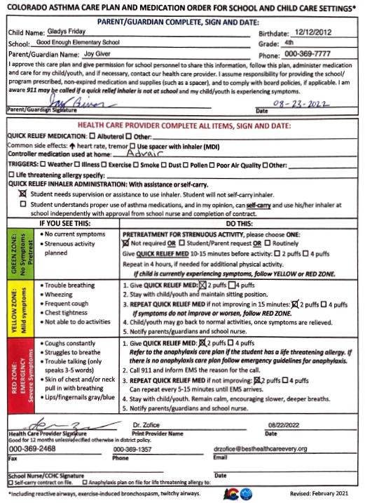
Case Study:
HCP/Order
Notes:
Let’s take a look at an example of an order we might see in the school setting.

Slide 93
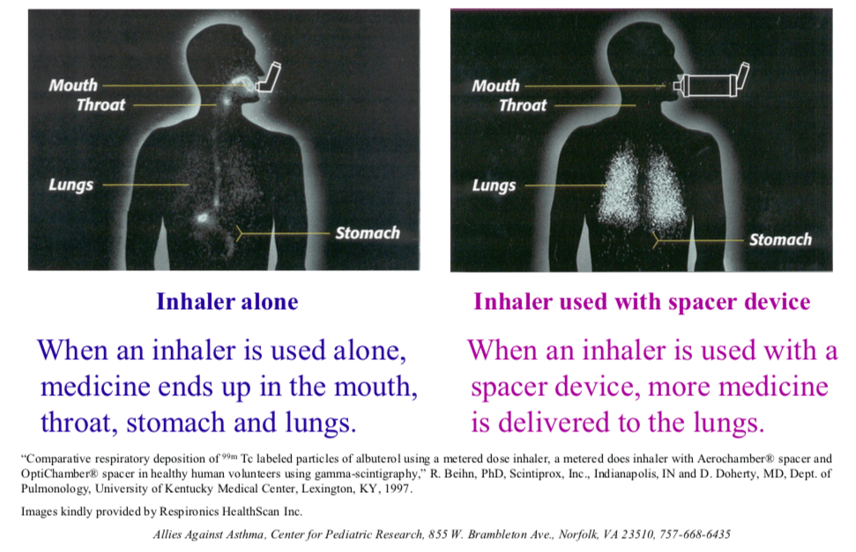
Why Use a Spacer with an Inhaler?
When promoting asthma self-management skills, it is helpful to use teaching aides like this poster that demonstrates the importance of using a spacer.
BACK uses resources like this teaching aide to use while working with young children and others with low health literacy.
Notes:
Case management includes promotion of self-management skills. Using tools like this teaching aid can help motivate a child to use their spacer. When working with a student or their caregivers, you can refer back to the explanations on this slide to help educate them on why spacer use with inhalers, are so important.

Slide 94
Skill Set for Case Management
Compassionate and able to relate to needs of child/family Asthma Straw Challenge Instructions (activity)
Motivational skills to encourage adherence to asthma treatment plan
Good communication skills with the child and family members, school nurse, healthcare provider and other professionals
Critical thinking and problem solving to determine best approach to addressing needs
Organization and time management

Slide 95

Asthma Navigators Wear Many Hats
Identify and engage participants
Asthma educator
Link health care providers
Data collection
Partner with school nurses
Connect to community resources
Implement program
Tips for successful case management and care coordination:
  Establish trusting relationships
  Role clarification
Notes:
Asthma navigators are a valuable member of the health care team and help reduce the burden on school nurses and health care providers by engaging families and providing them with the resources they need to access care.
Essential components:
Partner with the school health team and become an integral part of the school
Identify and engage eligible students and their families to receive the program
Deliver asthma self-management education to students and their parents
Support school nurses in asthma care coordination
Connect with health care providers to enhance communication/improve care
Assist families in reducing and eliminating barriers to health care access
Collect data for research

Slide 96

Establishing Trust
High trust behaviors include:
  Honest/transparent
  Demonstrate respect
  Clarify expectations
  Practice accountability
  Listen first, do not assume
  Keep commitments
Notes:
Navigators have the unique opportunity to establish trust with families and are the link that will help to extend that trust to the larger health care system. Trust is a key competency for success. Develop, restore, and extend trust.
Distrust in health care services and providers contributes significantly to delays in treatment services, the receipt of less than quality services, and increased rates of nonadherence to treatment

Slide 97
Playbook
1:45-2:15
Part of your homework before training was to become an expert on our website, coloradokidswithasthma.com. Let's walk through some sections and get to know it better.
What questions do you have about the website?

Slide 98
Next Steps
Review your notes from training and submit any questions
Training will continue weekly on Thursdays from 9-10
REDCap training invites are in your calendar
  We will have seven 2-hour sessions to get plenty of practice in before schools starts
You are welcome to spend time in REDCap exploring and playing as you please
Time to distribute materials!

Slide 99
Post Assessment

