Slide 1

Asthma Navigator Training
Day 2
June 13, 2023

Slide 2
Agenda
8:00-8:30 Team Building
8:30-9:00 Visit structure
9:00-11:00 Review Visit 1 and Role Play
11:00-12:30 Inhaler technique
12:30-1:00 Lunch
1:00-3:00 Review Visit 2-3 and Role Play
3:00-3:15 Break
3:15-4:45 RedCap Practice

Slide 3
Team Building
8:00-8:30
Grab a piece of paper and write a fun fact about yourself
Put it in the bowl
We will each draw a fact and guess who wrote it

Slide 4
BACK Program Overview
Before providing intervention,
  Identify eligible students- review of completed Asthma Intake Form
  Enrollment process- work with school nurse to invite eligible families, explain study and ascertain interest in study/program
  Attainment of informed consent and assent
Now you are ready to begin intervention!
Provide 3 visits to students and families over school year.
  Family/caregiver visit is either in-person or remote (telephone/Zoom)
    5% of Zoom visits will be recorded for each Asthma Navigator
  Student visit is in-person at the school
Each visit includes 1) assessment, 2) tailored asthma education, 3) closing and next steps and 4) provision of asthma education materials and encounter letter sent to health care provider and copy to family (visits 1 and 3 and visit 2, if uncontrolled asthma)

Slide 5
Visit Structure
8:30-9:00

Slide 6
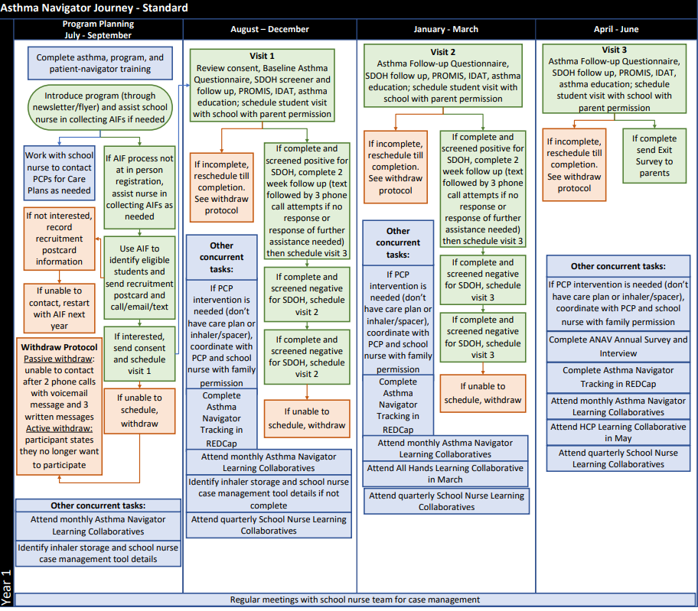
BACK Program Roadmap

Slide 7
Program Planning
9:00-9:20

Slide 8
BACK Program Planning
Introduce BACK program at each of your assigned schools
Different methods for program introduction
  Attend in-person school registration
  Attend other back to school events
  Sends and/or post a newsletter or flyer about the program

Slide 9
Support School Nurse with Back to School Activities to Identify Students with Asthma
Support completion and collection of Asthma Intake Forms (AIF)
Review the AIF to identify eligible students
Send recruitment postcards with nurse support to those eligible

Slide 10
Identify students with asthma
Let’s review how we figure out who to recruit for the program
Find out who has asthma – every school is different
  School health forms
    Completed at registration
    Completed at other times
    Online or paper
Support completion of Asthma Intake Forms
Review AIFs for eligibility

Slide 11
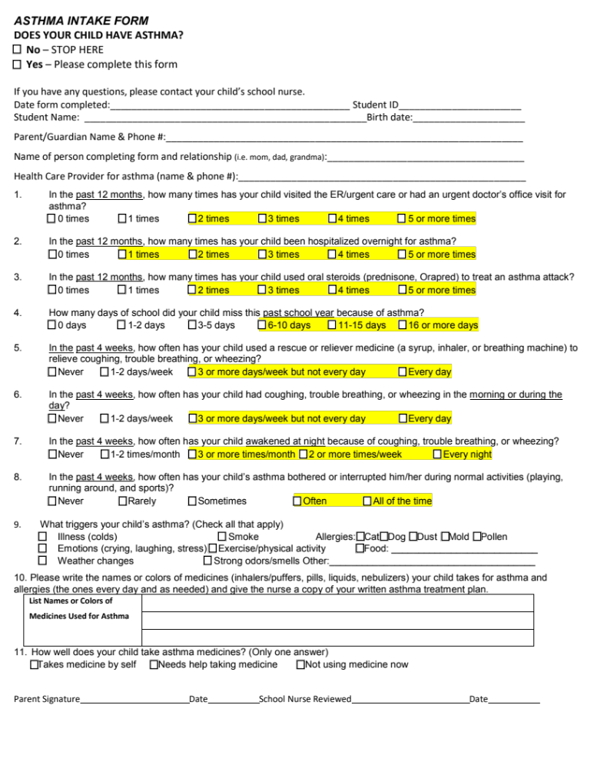

Asthma Intake Form
Your cheat sheet

Slide 12
Recruiting Eligible Families
Once know which families are eligible, provide additional information, determine interest in participation and for those interested attain informed consent and assent.
Work with school nurse to contact eligible families through a set of invitation letters sent from school nurse (3-5 attempts)
  1st letter (BACK explanation and permission to contact form) asks families who are interested to provide their contact information
  2nd (BACK letter) tells families that we will reach out to them unless they let us know they are not interested
AN follows up with those interested after the first letter and those that don’t respond “no” to the second one to try to recruit them into the program

Slide 13
Recruitment Process
Send Recruitment letters
Open to more info?
Yes – Okay to contact by AN
AN Contact by phone or email
Schedule Visit 1 and send informational materials

Slide 14
Recruitment Process
Send Recruitment Letter
Interested?
No
Provide reason not interested
Unable to contact Restart with AIF next year

Slide 15
Tracking Recruitment Activities
Track overall recruitment activities in the Beginning of School Year form
  Let’s walk through the paper version of that form together
Track specific student information during recruitment in the Student Recruitment form
  Let’s walk through the paper version together

Slide 16
Visit 1
9:20-11:00

Slide 17
Once visit one is scheduled
Send information letter and informed consent/assent at least 3 days prior to the caregiver visit
Send a second reminder via the preferred method of communication of the visit if it was scheduled more than 5 days prior

Slide 18
Visit 1 with Families: Overview
Visit occurs between September - December
Let’s use the Visit 1 Log to walk through the visit
Beginning of visit involves attaining informed Consent/Assent
Following attainment of consent and assent, collect baseline information/data
  Baseline Asthma Navigator Questionnaire- Wait list
  Baseline Asthma Navigator Questionnaire- Intervention
  SDOH Screener
If at any point, the visit needs to be cut short, schedule a follow up before ending the visit
  Use the Rescheduling Log to guide you through that process

Slide 19
Token of Appreciation for visits
After each family visit, a $20 gift card will be email by study team
  Once you check “completed visit” in your Visit Logs, I will send
  Gift cards will be emailed once a week

Slide 20
Visit 1 with Families- Intervention
Following completion of Asthma Navigator Baseline Questionnaire- Intervention, SDOH Screener
  Provide SDOH Conversation and referral based on SDOH Screener
  Provide asthma education and tailor to family
    What is asthma, asthma medications, triggers, inhaler technique

Slide 21
Post-family Visit 1 Activities: Intervention
Send a letter to their Health Care Provider (HCP) and a copy to the family – will review more in depth later during REDCap training
Send asthma education material to reinforce teaching
The study team will send the Post-Baseline Demographics Survey
Complete a SDOH 2-week Check In if resources were provided during the visit
Follow-up with school nurse to update following
Notes:
Asthma education materials should be given in person if the visit was in person
Post-baseline will be sent by study team
Need to discuss the gift card process

Slide 22
Student Visit 1 Activities: Intervention
Work with school nurse to schedule school visit with the school nurse
  Ideal to schedule all the students at one school during a single day or two
Complete activities:
  Assent (if not completed during caregiver visit)
  Inhaler Device Assessment Tool (IDAT)
  Provide asthma education
    Inhaler teaching with demonstration and teach back
    What is asthma
    Controller vs. quick relief medications
    Teaching technique: Role play 1: Explain asthma to your teacher
  Give swag bag
Notes:
Melanie – do you have materials about role plays – should be in the playbook
Lesson plan for visit 1, 2 and 3

Slide 23
Visit 1 in REDCap
Let’s walk through the forms in REDCap that you use for visit 1
  Consent/Assent
  Intervention Baseline Navigator Questionnaire- Wait list
  Intervention Baseline Navigator Questionnaire- Intervention
  SDOH Screener (already reviewed)
  SDOH Conversation (already reviewed)
  IDAT (student only)
Notes:
Waitlist as a follow up training topic

Slide 24
Let’s Apply Learning: Assessment Role Play
AsthmaCOMP Nav will demonstrate assessments
Pair up with an AsthmaCOMP Asthma Navigator to role play visit 1 and use paper versions to collet the data. We will use the paper versions as REDCap practice later
  Start with Consent and work through the forms
Notes:
Record demonstration on the phone
Asthma comp nav pretends to be the family
See one, do one, teach one
2 comp navigators
Go over baseline questionnaire (parts of it)

Slide 25
Inhaler Technique
11:00-12:30
Review all device techniques as group
Divide into pairs for 1:1s demonstration and teaching
Inhaler post assessment

Slide 26
Accurate Inhaler Technique:
A Must
Students should know how to:
Use the device.
Tell when the device is empty.
Clean the device.
Check inhaler technique at every visit.

Slide 27
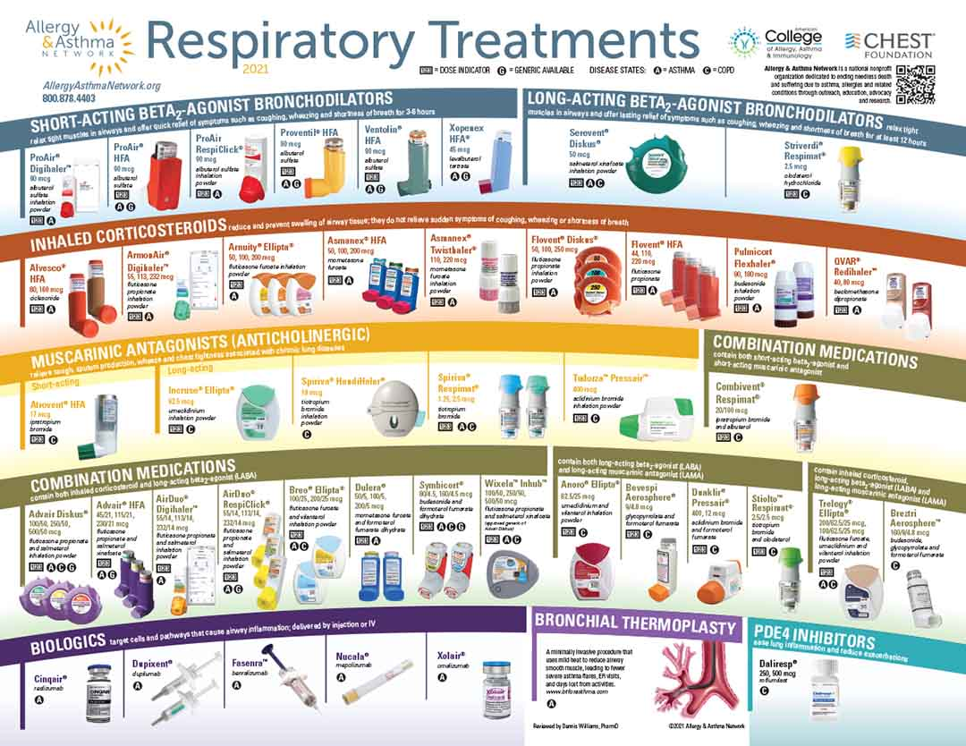
Inhalational Devices

Slide 28
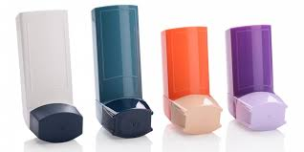
Types of Devices
Metered Dose Inhaler (MDI)
  A pressurized canister of propellant and medicine in a plastic holder with a mouthpiece.
  Delivers a reliable and consistent dose of medication.

Slide 29
Metered Dose Inhaler (MDI)
Pros:
Pressurized propellant pushes the drug into the airways.
Accidentally breathing out a little while using will not cause a problem in the delivery of the medicine.
Cons:
Requires coordination- must coordinate breathing in with actuation/release of medication.
Most difficult to use.
Patients can commit critical error and not receive any medicine.

Slide 30
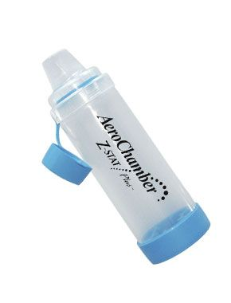
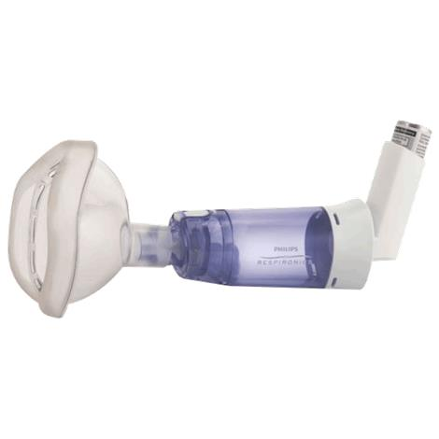


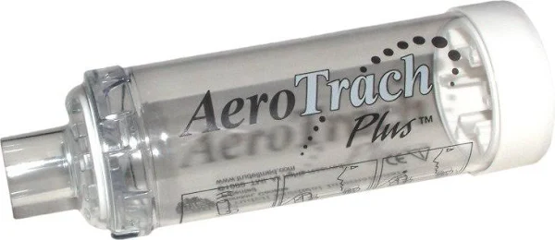
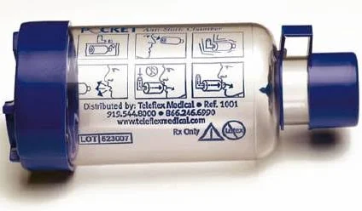
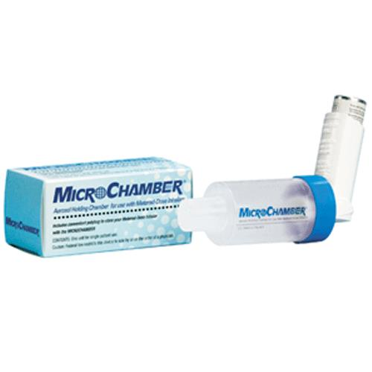
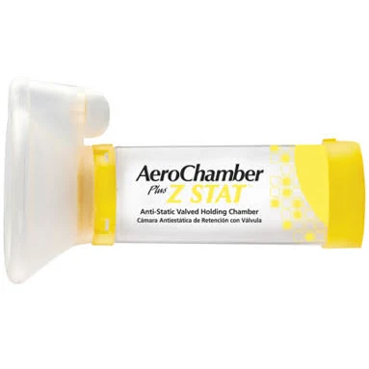
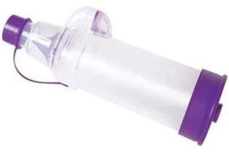
Valved Holding Chambers (Spacers)
Spacers are available in for students.

Slide 31
Valved- Holding Chambers/Spacers
NOT used with DPIs or Breath-Actuated Devices.
Purpose:
  Ensures medication is delivered to lungs.
Advantages:
  Easy to use: Less coordination required for MDI use.
  May breathe in and out several times to receive complete dose.
  Faster delivery than nebulizer and less expensive.
Disadvantages:
  More cumbersome than MDI alone
  Extra expense
Still must rinse mouth with inhaled steroid use.
Notes:
Changed steroid to corticosteroid ELL 9-5-11
Children <4-5 years need to use a holding chamber w/ a mask
Holding chambers can increase the uptake of a drug by up to 30%
$40-$53 for aerochamber

Slide 32
Selecting Appropriate Devices
MDI alone: most difficult to use and often results in sub-optimal medication delivery to airways
MDI with spacer: easier to correctly use MDI.
  With mask:
    Children < 4 years
    Older people experiencing difficulties with MDI technique
    People with cognitive delays and/or developmental issues
  With mouthpiece:
    Children > 4 years
Dry powder inhalers
  Children >4-5 years
Notes:
Capitalized appropriate ELL 9-5-11

Slide 33
Inhaler Technique
Basics

Slide 34
Basic Technique
Prepare device.
Breath out.
Breath in appropriately for device.
Hold count of 10.
Breath out.

Slide 35
Spacer PLUS MDI

Slide 36
MDI with a Mouthpiece Spacer
Remove caps (spacer and MDI).
Shake MDI.
Insert inhaler into spacer.
Breathe out normally and place mouthpiece between teeth with closed lips around it. Opening should not be blocked by tongue.
Spray one puff into the spacer by pressing down on the inhaler.
Breathe in slowly and deeply.
Hold breath for the count of 10.
Exhale.
Notes:
Corrected spelling of mouthpiece ELL 9-5-11
Read the slide. (Slide matches the handout.) Demonstrate these steps on how to use the inhaler and allow time for practice.

Slide 37
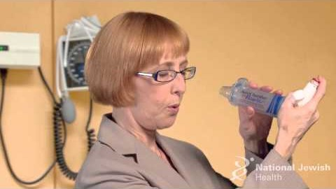
Using a Spacer (Aerochamber®)
https://www.youtube.com/watch?v=ltB-ZOjlkgY&feature=youtu.be

Slide 38

Spot the errors: MDI + Spacer

Slide 39
MDI + Spacer Errors
  Did not shake inhaler. This does not mix the medication and the propellant. Propellant is heavier and sits at the bottom of the canister, so mixing is important.
  Too many (3) puffs. This results in more propellant being delivered than medication, so the overall dose delivered is less.
  Did not hold breathe for count of 10. This decreases delivery of medicine to smaller, distal airway branches.

Slide 40
MDI with a Mask Spacer
Remove caps (spacer and MDI).
Shake inhaler.
Attach inhaler to end of spacer.
Place mask over the person's nose and mouth. Ensure good fit/mask seals around nose and mouth.
Spray one puff into the spacer.
Watch person breathe in and out for 5 breath cycles (breathing in and out).

Slide 41
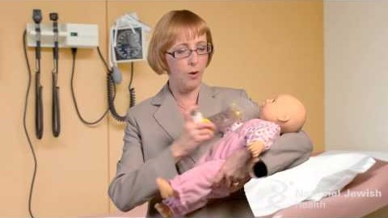
Spacer (Aerochamber®) with mask
https://youtu.be/g6Q366RIlE8

Slide 42
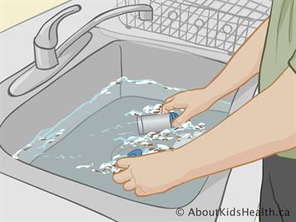
Preparing and Cleaning Spacers
Cleaning spacer
  Powder residue not harmful.
  Clean periodically in warm soapy water, let air dry, no need to rinse.
  Rinsing in water alone can cause an electrostatic charge, reducing effectiveness.

Slide 43
Metered Dose Inhalers

Slide 44
Pressurized MDI Technique
Remove cap.
Shake vigorously.
Place the mouthpiece in your mouth (between teeth) with lips sealed around.
Following a slow, relaxed exhalation, start a slow inhalation.
Depress canister once during start of inspiration. Continue to inspire/inhale (about 5 secs).
Hold breath 10 seconds.
Notes:
Comma after mouth on bullet 2 ELL 9-5-11

Slide 45
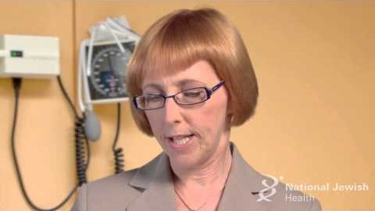
MDI: Closed-Mouth Technique
https://youtu.be/9ipqxF-4p5g

Slide 46
Cleaning MDIs
Clean mouthpiece once per week (if using daily).
  Remove medication metal canister and mouthpiece.
  Do not wash or immerse the metal canister in water.
  Run warm tap water through the top and bottom of plastic mouthpiece for 30 seconds.
  Shake off excess water and allow the mouthpiece to dry completely (overnight is recommended).
  If inhaler needed before the mouthpiece is dry, shake off excess water, replace the canister, and test spray two times (away from the face).

Slide 47
Common Mistakes: MDI
Inhaling too fast.
Failure to hold the inhaler upright.
Not breathing out before inhaling the medication.
Not shaking inhaler before use; incorrect dose loading.
Inhaling through nose instead of mouth.
Pushing the inhaler/actuating more than 1 spray.
Not cleaning the inhaler.

Slide 48
Spot The Errors: MDI

Slide 49
MDI Errors
  Did not shake inhaler. This does not mix the medication and the propellant. Propellant is heavier and sits at the bottom of the canister, so mixing is important.
  Did not exhale first so will not be able to inhale fully.
  Inhaled too quickly and not deeply for the device so not delivering the full dose to the airways.
  Did not hold breathe for count of 10. This decreases the delivery to smaller, distal airway branches.

Slide 50
Let’s practice!
Notes:
Melanie to bring kits

Slide 51
Lunch
12:30-1:00

Slide 52
Visit 2 and 3
1:00-3:00
Visit Overview
Data collection forms
Educational materials
Tailoring education
Role Play

Slide 53
Visit 2 and 3 Overview
Visit 2 happens from January – February
Visit 3 happens from April-May
Caregiver visits could occur over the phone, Zoom, or in person (family preference)
Student visits occur at school to assess inhaler technique (IDAT) and provide further asthma education.
Let’s walk through Visit 2 and 3 Logs

Slide 54
Caregiver/Family Visit 2 Activities
Schedule Visit 2 using Visit 2 Scheduling Log
Send 1 week and 24-hour reminders with a note to fill out the Post-Baseline Demographics Survey (if have not completed) and the Pre-Visit survey before the visit. REDCap automatically send these to their email
Review completed Pre-Visit survey prior to visit
If Pre-Visit survey or Post-Baseline Demographics Survey is not completed, you will need to complete during the visit
Administer Asthma Navigator Follow up Questionnaire for assessment, and SDOH Follow up
Provide asthma education and tailoring
  Asthma Action Plan and CO Asthma Care Plan for Schools and Child Care Settings, review inhaler technique, Exercise Induced asthma and other Asthma Triggers,
Provide a gift card to the family for completing the visit and schedule visit 3
Do an SDOH check in after 2 weeks if any new resources were provided to the family

Slide 55
Student Visit 2 Activities
Schedule Visit 2s with school nurse. Again, try to complete all students’ visit 2 in 1-2 visits to school
Assess inhaler technique and complete IDAT
Asthma education
  Review and reinforce inhaler technique
  Assess asthma control
  Exercise/Being physically active with Asthma and Managing Triggers,, Review Worsening Asthma/Asthma Action Plan and How to Respond: Medication Use Controller vs. Quick-Relief,
  Education activity: role play 2- Traffic light zones

Slide 56
Caregiver/Family Visit 3 Activities
Similar to Visit 3
Send 1 week and 24-hour reminders with a note to fill out the Pre-Visit survey before the visit. The study team will send the survey to their email
Review completed Pre-Visit survey prior to visit
Complete Asthma Navigator Follow up Questionnaire for assessment
Complete SDOH Follow up
Provide asthma education
  Don’t let Asthma Sideline your Child, Back to School Readiness plus review asthma inhaler
Provide a gift card for completing the visit

Slide 57
Student Visit 3 Activities
Work with school nurse to schedule school Visit 3. Again, try to complete all students’ visit 3 in 1-2 visits to school
Assess inhaler technique and complete IDAT
Asthma education
  Review and reinforce inhaler technique
  Assess asthma control
  Asthma education: Review and Putting it All Together
    Being physically active
    Monitoring asthma control
    Recognizing and responding to worsening asthma
Education activity role play 3: Trigger management during physical activity and what to do

Slide 58
Post Visit Activities for Visits 2 and 3
VISIT 2: If poorly controlled asthma or no inhaler and/or completed CO Asthma Care Plan and Medication Order for Schools, send a letter to their Health Care Provider (HCP) and a copy to the family
VISIT 3: Send follow-up letter to their provider
  Let’s take a look at the letter in your binder
Send asthma education material to reinforce teaching
Follow-up with school nurse to update following each visit 2 and 3

Slide 59
Visit 2 and 3 in REDCap
Post Baseline Demographics Survey
Pre-visit Survey
Follow up Navigator Questionnaire
SDOH Follow up
IDAT

Slide 60
Closing Your Visits
Identify your assessment
  Asthma control
  CO Asthma Care Plan and Medication Order for Schools status
  Accompanying reliever at school status
  Possession of Asthma Action Plan for School
Identify the gaps
Mutually agree on next steps to address gaps
  Steps for family
  Steps for Asthma Navigator
Schedule next visit for 2 and 3

Slide 61
Role Play: Education and Closing
The AsthmaCOMP Navs with demonstrate tailoring education and closing the visit
Now, pair up and practice the teaching asthma education topics and closing the visit
Notes:
Comp navs will demonstrate more complicated

Slide 62
REDCap
3:00-4:45
Review paper versions of Anav tracking form and Anav adaptations form
Discuss data organization and collection best practices

Slide 63
Data Organization and Best Practices
Data management isn’t the most fun but it is extremely important
Need to stay up to date with your data collection
If you fill out the forms with families on paper, you should enter them into REDCap by the end of the same day or the next morning at the latest
Paper forms with personal information need to be stored in a locked location that only you have access to or shredded once entered
Documents on your laptop need to be saved in Egnyte so if something were to happen to your computer, it is saved in a secure location
  Every ANav will have their own folder on Egnyte
Notes:
Misha to present

Slide 64
REDCap Practice
Use the data you collected during the role plays and enter them into REDCap. Enter as much as you can, and the rest is homework

