Slide 1

Asthma Navigator Training
Please complete the Inhaler Pre-Assessment as you arrive!
Day 1
June 13, 2023

Slide 2
Agenda
10:00-10:15 Introductions and IDAT Pre Assessment
10:15-11:15 Team Building
11:15-1:00 Asthma Training
1:00-1:30 Lunch
1:30-2:00 Project Overview
2:00-2:30 Asthma Navigator Role
2:30-3:30 Data Collection and REDCap Overview
3:30-3:45 Break
3:45-5:15 Social Determinants of Health
5:30 Cedar Creek Pub Dinner Reservation

Slide 3
Introductions
Let’s meet each other!
Share your name, background, and something about yourself you’d like for everyone to know

Slide 4

Core Research Team
Stan Szefler MD (Co-PI) –Asthma/School-based research
Lisa Cicutto RN, ACNP(CERT), PhD (Co-PI) – Rural community engagement, Asthma/School-based research
Amy Huebschmann MD, MSCS (Co-PI) – Dissemination and Implementation science
Melanie Gleason PA, MS – Asthma/School-based programs – major role in implementing/training
Arthur McFarlane - Asthma/School-based evaluation and social determinants of health outreach
John Brinton, PhD – Biostatistician, design and analysis
Lisa DeCamp MD, MSPH – general pediatrician, health disparities research
Sarah Brewer PhD – Mixed methods and qualitative research
Julia Reedy MA – Qualitative Analysis
Misha Brtnikova, PhD, MPH - project manager
Holly Coleman, MSW – Trailhead partner, Director of Philanthropy & Community Engagement
Anowara Begum, MPH – Senior research services professional
Rachel Armstrong – Research services professional

Slide 5
Icebreaker and Community Agreement
10:15-11:15

Slide 6
Who did it?
Everyone write something they have done on a piece of paper and put it in the bowl
I will pull one at a time to read
Everyone will try to guess who did the activity

Slide 7
Community Agreement
Everyone share expectations and norms you have for the group
We will create a community agreement out of these ideas
Notes:
Where is the QR code?

Slide 8
Asthma Review
11:15-1:00
Supplement asthma management topics from pre work: what is asthma, diagnosing, asthma control, medications, triggers, need for regular follow up care

Slide 9

Asthma: Burden
Poorly controlled asthma costs (indirect and direct): $19 billion/year. (Yaghoubi M AJRCCM 2019)
Common cause of urgent care and hospitalizations for children.
More than 50% of kids with asthma limit their activity.
Notes:
2
Poorly controlled asthma of $14 billion per year for poorly controlled asthma

Slide 10




GOAL: Students in school and ready to learn
but asthma can ...
cause absenteeism, about 13 million days/year
decrease academic performance
limit student participation in classroom activities, physical education, and school events

Slide 11
Why Asthma?
Asthma cannot be cured, but it can be controlled with proper management.
Schools can support asthma control achievement by
Adopting asthma-friendly policies and procedure;
Coordination among health care providers, school personnel, and families;
Providing asthma education for all students and staff

Slide 12
Asthma Medications
2 broad categories
  Reliever/rescue inhalers
  Preventer/controllers

Slide 13
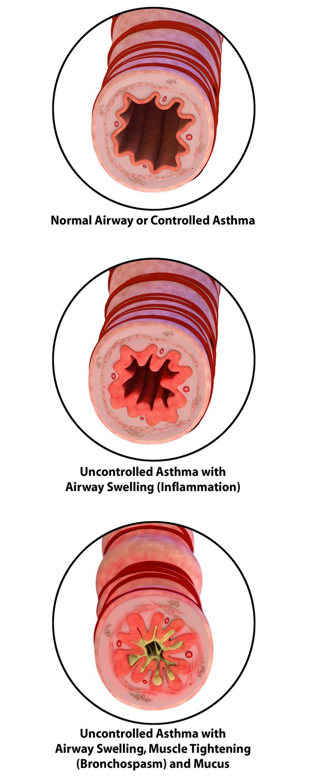
What is Asthma?
RECURRENT cough, wheeze, chest tightness, shortness of breath
REVERSIBLE (gets at least partially better) with a bronchodilator (inhaled medicine like albuterol)
REACTIVE Symptoms often have specific triggers like exercise or allergies

Slide 14
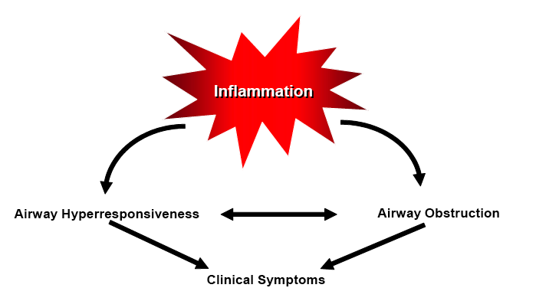
Pathology of Asthma
Airway inflammation
Airway obstruction (reversible)
Hyperresponsiveness (irritability of airways)

Slide 15
Diagnosis of Asthma
Diagnosis of asthma based on:
  History of episodic symptoms related to airflow obstruction or airway hyperresponsiveness
  Evidence of variable airflow obstruction from bronchodilator reversibility testing or other tests
  Alternative diagnoses are excluded
Document evidence for the diagnosis in patient’s chart, preferably before starting controller treatment
  More difficult to confirm the diagnosis after treatment started
Recommended methods to establish the diagnosis:
  Detailed medical history
  Physical exam focusing on the upper respiratory tract, chest and skin
  Spirometry to demonstrate obstruction and assess reversibility, including in children 5 years of age or older
  Additional studies to exclude alternate diagnoses

Slide 16

Diagnosing Asthma: Medical History
Symptoms
  Coughing
  Wheezing
  Shortness of breath
  Chest tightness
  “Trouble breathing”
Pattern of symptoms
Severity
Family History
  Asthma
  Allergies
Notes:
Diagnosing Asthma: Medical History
16

Slide 17
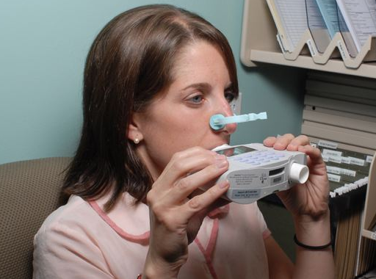
Diagnosis of Asthma - Partially Reversible Airflow Obstruction
Use spirometry to establish airflow obstruction
  FEV₁ is reduced (< 80% of predicted)
  FEV₁/FVC is reduced (>0.75 – 0.80 in healthy adults, and >0.90 in children)
Notes:
Read Slide
Many providers will skip this step and attempt to establish a diagnosis only on symptoms or a “hunch” or they’ll use a PFM which is not an appropriate to verify asthma.
The reversibility of at least 12% of obstruction is the standard.

Slide 18
Ongoing Asthma Assessment and Monitoring
Asthma Control

Slide 19
Asthma Assessment and Monitoring
Asthma control - two domains to assess
  Symptom control and beta₂ use over the last 2-4 weeks
  Risk factors for poor outcomes, including low lung function

Slide 20
Assessing Control
How often have you:
Experienced asthma symptoms (coughing, wheezing, trouble breathing, chest tightness?): More than two days a week is too much
Used the quick-relief medication (SABA)?: more than twice a week is too much
Woken up at night or in the morning with asthma symptoms?: once a week is too much- no more than 2 nights per month
Decreased or not done an activity (like sports, play or games) because of your asthma?
Additional question
Has anyone needed to go to the emergency room or walk-in the Convenient Care Clinic for an asthma attack or flare-up?

Slide 21
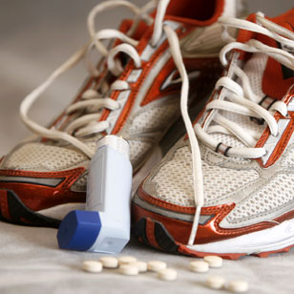
Treating Asthma to Control Symptoms and Minimize Risk

Slide 22
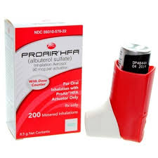
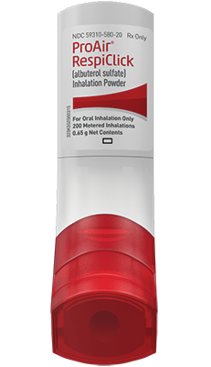
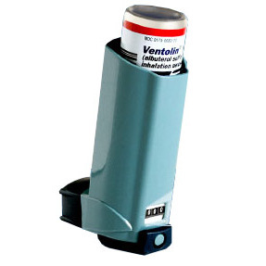
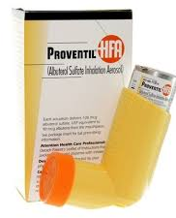

Short-acting beta₂-agonist (SABA): Reliever or Rescue Inhaler
ProAir® HFA (albuterol sulfate)
  MDI
ProAir Respiclick®(albuterol sulfate inhalation powder)
  Breath Actuated
Proventil® HFA (albuterol sulfate)
  MDI
Ventolin® HFA(albuterol sulfate)
  MDI
Xopenex HFA® (levalbuterol tartrate)
  MDI
Notes:
Changed steroid to corticosteroid ELL 9-5-11

Slide 23
Short-acting beta₂-agonist (SABA)
  Other names: Rescue or Reliever Inhaler
  Indication:
    Relief from difficulty breathing- coughing, dyspnea, wheeze.
    Pre-treatment for physical activity.
  Mechanism of action: Relaxation of airway smooth muscle by binding to beta₂ agonist receptor site on muscle.
  Onset of action: Minutes
  Duration: 4-6 hours
  Side effects: Jitteriness, headache, increased heart rate.

Slide 24
Controller Inhalers
Used daily for long term control of disease
All people with persistent asthma should have one.
  About 70% of people with asthma have persistent asthma
Taken 1 or 2 times a day to provide round the clock coverage.
  In contrast to relievers that are taken PRN in asthma.
Classification types:
  Inhaled Corticosteroids (ICS)
  Long-Acting Beta₂ Agonists (LABA)
  Long-Acting Muscarinic Antagonists (LAMA)
  Combination inhalers

Slide 25
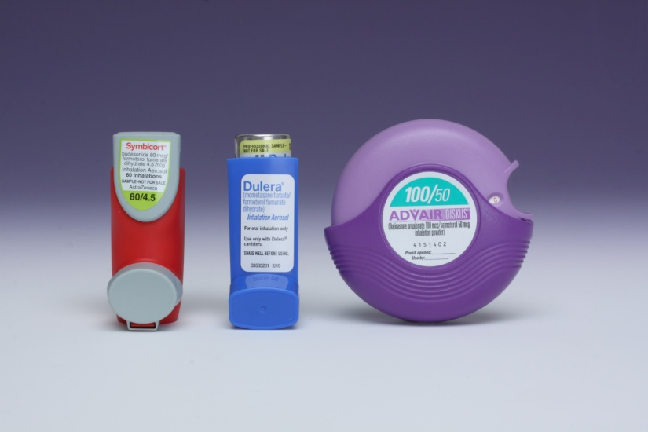
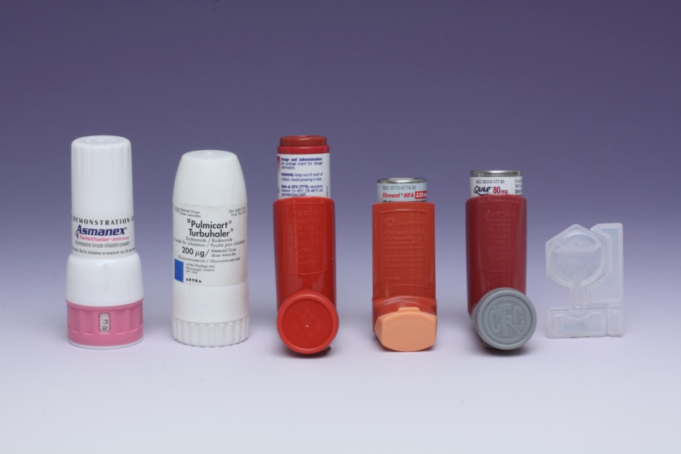
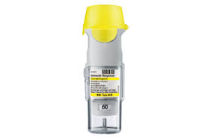
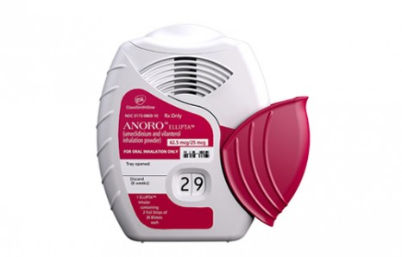
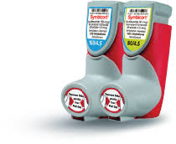
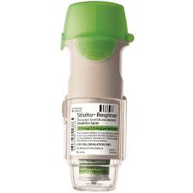
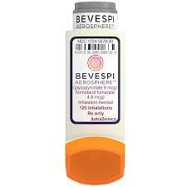
Controllers

Slide 26
Anti-inflammatory Agents
Inhaled corticosteroids (ICS)
  Most effective long-term therapy for persistent asthma.
  Suppresses airway inflammation.
  Inhaled route is preferred to oral because of fewer side-effects.
  Greatest benefit achieved with relatively low doses, whereas the risk of adverse effects increases with dose.
Notes:
Changed steroid to corticosteroid ELL 9-5-11

Slide 27
Inhaled Corticosteroids (ICS)
Alvesco® (ciclesonide)
MDI
Arnuity® (fluticasone)
DPI
Asmanex® (mometasone)
MDI
Twisthaler® DPI
Flovent HFA® (fluticasone)
MDI
Diskus DPI
Pulmicort® (budesonide)
Flexhaler® DPI
Respules®
Qvar® (beclomethasone)
Breath actuated Redihaler
Notes:
Changed steroid to corticosteroid ELL 9-5-11

Slide 28
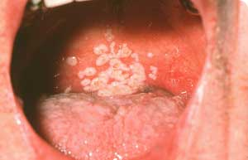
Inhaled Corticosteroids (ICS)
Mechanism of action: broad spectrum anti-inflammatory agent which by shuts down producers of inflammation.
Onset of action: Days to 3 weeks
Side effects:
  Short-term
    Thrush (oral candidiasis)
    Sore throat
    Hoarseness
    Dry mouth
  Long-term with high dosages
    Osteoporosis
    Cataracts
    Initial growth retardation that is recovered (children)
Notes:
Changed steroid to corticosteroid ELL 9-5-11

Slide 29
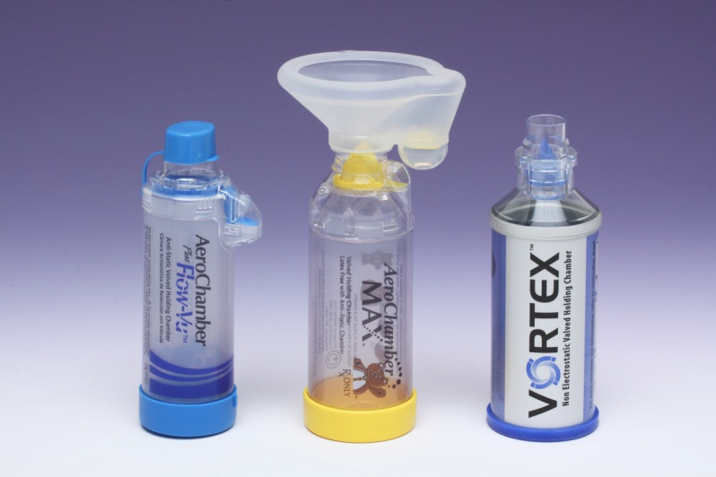
Inhaled Corticosteroids
Preventing common side effects
  Rinse, gargle, and spit following use of inhaled corticosteroids.
  Spacers or valved holding chambers (VHCs) used with non-breath-activated MDIs to reduce side effects.
Notes:
Changed steroid to corticosteroid ELL 9-5-11

Slide 30
Spacers or Holding Chambers
Purpose
  Ensure medication is delivered to lungs
Advantages
  Easy to use: Less/No coordination required
  May breathe in and out several times to receive complete dose
  Faster delivery than nebulizer and less expensive
Disadvantages
  More cumbersome than MDI alone
  Cleaning required
  Expensive
Still need to rinse mouth following use of inhaled corticosteroid
Notes:
Changed steroid to cortciosteroid ELL 9-5-11
Children <4-5 years need to use a holding chamber w/ a mask
Holding chambers can increase the uptake of a drug by up to 30%
$40-$53 for aerochamber

Slide 31
Preparing and Cleaning Spacers
New spacer preparation
  If electrostatic-free, no preparation needed
  Should be treated to reduce the electrostatic charge. Wash in warm soapy water. Let dry. No rinsing of soap.
Cleaning spacer
  Powder residue not harmful
  Clean periodically in warm soapy water, let air dry, no need to rinse
  Rinsing in water alone can cause an electrostatic charge, reducing effectiveness

Slide 32
Oral Corticosteroids
Strongest anti-inflammatory because given in larger doses and systemically
Used to treat flare-ups, asthma worsenings, exacerbations
Given after ED visit and hospitalization
Route: pills, liquid, shot (IM), IV (intravascular)
Names: prednisone, prednisolone, methylprednisolone, Pediapred, dexamethasone

Slide 33
Controllers
Combination Inhalers: ICS + LABA
  Inhaled corticosteroid (ICS) and long-acting beta2 agonists (LABA) combination in a single inhaler
  Effective and convenient treatment for patients with asthma and COPD.
  Very commonly used in persistent asthma.
    Updated 2020 national asthma guidelines include using this combination inhaler as a “reliever” PRN medication used to relieve present symptoms
    The LABA component must have a quick onset of action like formoterol or vilanterol
Notes:
Changed steroid to corticosteroid ELL 9-5-11

Slide 34
Combination Controller Inhalers: ICS + LABA
Mechanism of action:
  LABA- Relaxes airway smooth muscle
  ICS- Suppresses airway inflammation
Onset of action:
  LABA- Few minutes; 15 minutes for salmeterol
  ICS- Days to 3 weeks
Duration:
  LABA- 12-24 hours
  ICS- Days (if used regularly for several weeks)
Side effects:
  LABA- Shakiness, jittery, anxious feeling, headache, palpitations, increased heart rate
  ICS- Hoarse voice, thrush, sore throat

Slide 35
Combination Controller Inhalers: ICS + LABA
Advair® (fluticasone & salmeterol)
  Diskus®, MDI
Airduo™ Respiclick® (fluticasone & salmeterol)
  Breath actuated MDI
Breo® (fluticasone & vilanterol)
  DPI
Dulera® (> 12yrs of age) (mometasone & formoterol)
  MDI
Symbicort® (budesonide & formoterol)
  MDI

Slide 36
Biologics
  Uncontrolled moderate-severe persistent asthma despite use of inhaled corticosteroids. Require 4-6 month trial
  Xolair® (omalumizab) - Anti-IgE
    Injections in physician’s office every 2-4 wks
    Recombinant humanized monoclonal antibody that selectively binds to IgE
      pretreatment serum IgE levels (30-1,300 IU/mL)
    6yrs and older
  Anti- IL5 biologics for eosinophilic asthma (blood eosinophils > 300 cells/µL
    Mepolizumab (Nucala), dupilumab (Dupixent) & Benralizumab (Fasenra)
      12yrs and older
      Subcutaneous injection
    Reslizumab (Cinqair)
      > 18 yrs old
      IV formulation

Slide 37
Asthma Triggers

Slide 38

Asthma Triggers
Irritants or allergens that trigger asthma symptoms
  Allergies
  Irritants
  Infections
  Strong Emotions
  Exercise
Triggers are unique to each person
Avoid, reduce or remove triggers
Notes:
People with asthma have extra sensitive lungs. When they are exposed to something called an asthma trigger, in their environment their lungs react.
Asthma triggers are unique to each child/individual as not everyone reacts to the same thing.
The important thing is to reduce or minimize exposure to known triggers.
Can anyone tell me what some common asthma triggers are?

Slide 39


Allergies
Common Allergens
Pollen
Mold
Dust Mites
Cockroaches/Rodents
Animal Dander

Slide 40
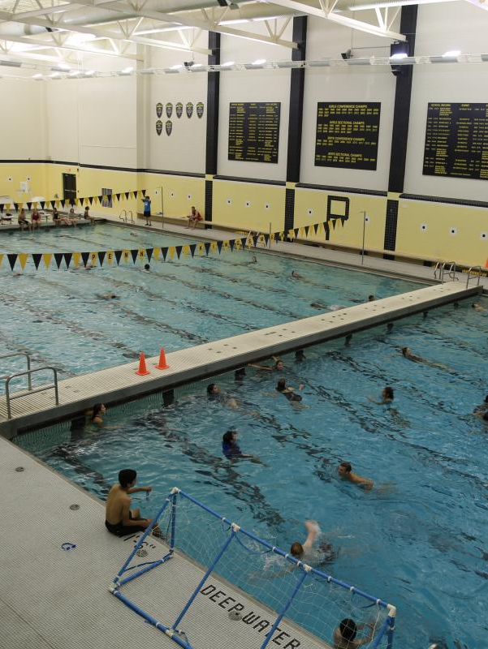
Irritants
Irritants are non-living substance such as diesel, smoke, cold, chemicals etc. which will cause irritation by their physical property of being an irritant

Slide 41
Common Triggers in Schools
Poor air quality
  Traffic related pollutants
Extremes in weather
  hot, cold, windy, humid, dry
Dusty environment
Allergens
  Mold
  Pets (carried on clothes,)
  Grass, trees, flowers, weeds
  Pests
  House dust mites
Strong odors/fragrances
  Personal care products
  Chemicals/cleaning products
  Air fresheners
Building construction
Physical activity
  Gym class
  Recess
Respiratory Infections

Slide 42



Strong Emotions
Stress and asthma are often seen together
Anxiety
Crying
Stress
Anger
Laughing hard

Slide 43



Illness
Respiratory infections increase airway inflammation, mucous production and airway hyperresponsiveness (twitchiness)
Colds
Flu
Bronchitis
Sinus Infections
Strategies
Practice good hand washing
Get annual flu shots
Keep hands away from your face
Notes:
Increased inflammation and mucous production exacerbate asthma symptoms
Get annual flu shots
Practice good hand hygiene
No sharing water bottles

Slide 44

Exercise/Physical Activity-Induced Asthma
One of the most common triggers
Exercise may lead to bronchospasm
Symptoms may occur during or after exercise
All students need to be physically active
Avoidance of exercise is not a solution

Slide 45
Strategies to Support Physical Activity Participation
Do not begin exercise if child has symptoms
1
Encourage child to participate
2
Use reliever (SABA) medication 10-15 minutes prior to exercise, if know activity will cause symptoms
3
Perform a gradual warm-up
4
Ensure easy access to reliever
5
If symptoms develop, use inhaler and have student rest until symptoms resolved
6
Notes:
Try to bring a positive spin….children can be active even when they have asthma

Slide 46
What is an Asthma Action Plan?
  A written set of instructions for home-based asthma management that:
  1. Stays with family until the next visit
  2. Provides instructions for daily treatment and treatment of worsening asthma (initiation or step-up treatment)
  3. Explains criteria for seeking medical attention

Slide 47
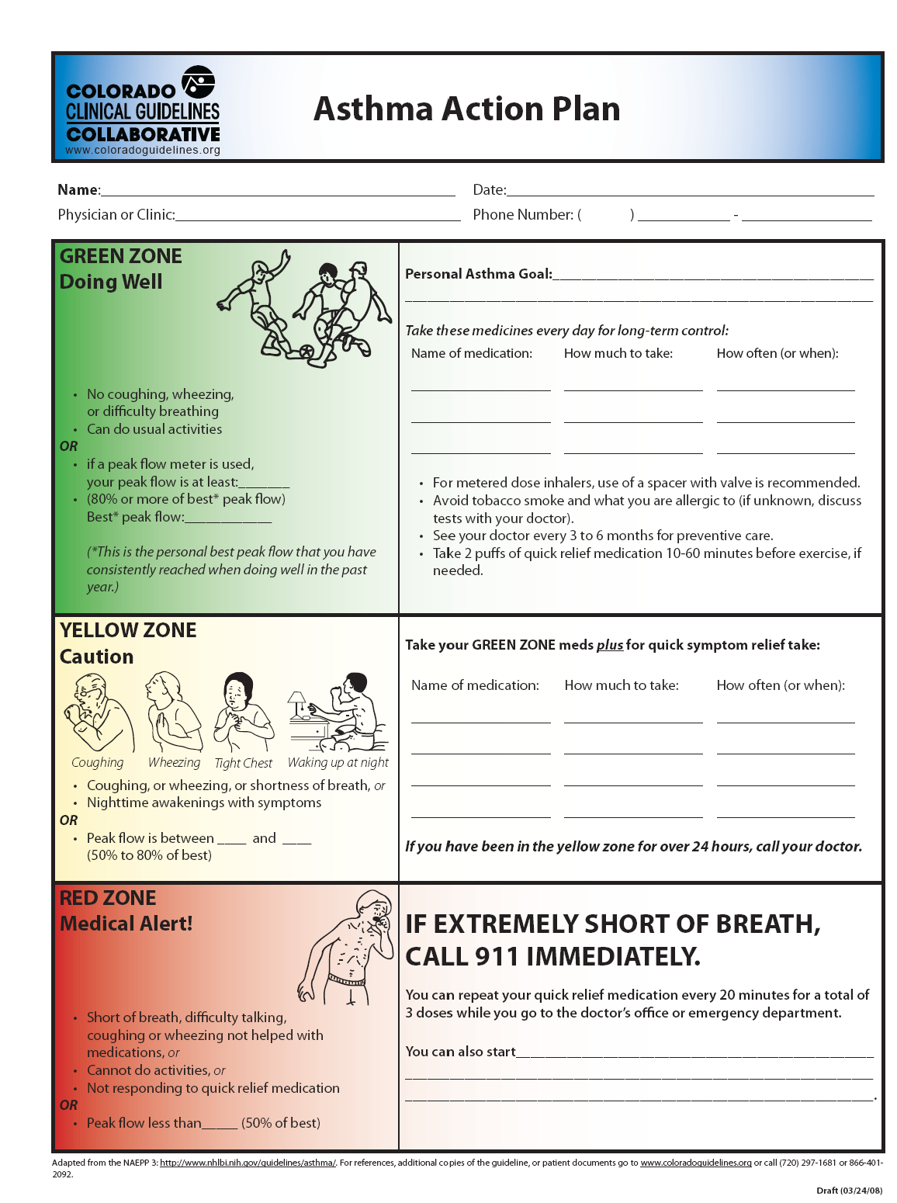

Slide 48

What are the components?
  Zones
    Traffic light analogy
  Indications for action
  Action
    Explicit directions to take in response to indicators for action that vary according to zone

Slide 49
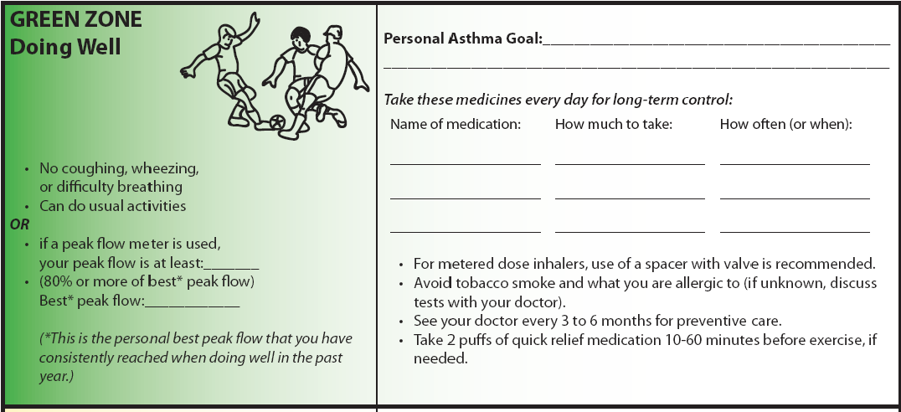
Green Zone: Good Control, Proceed as usual

Slide 50
Yellow Zone: Caution, time for action
  Indicates a lack of asthma control/ worsening asthma
  Time for action
    Enhance treatment
      Enhance with anti-inflammatories (corticosteroids)
    Possibly contact provider

Slide 51
Three Zones Plan
Red: STOP! Danger
  Indicates dangerously uncontrolled asthma
  Take immediate action
    Go to nearest emergency department
    Take bronchodilators enroute
    May also recommend taking prednisone

Slide 52
Regular routine visits with Health Care Provider
A necessity
Why?
  Asthma control assessment
  Adjustment of medications
  Patient education
  Determinations of expectations being met
  Get questions answered
How frequent?
  Usually every 6-12 months

Slide 53
Lunch
1:00-1:30

Slide 54
Project Overview
1:30-2:00
Better Asthma Control for Kids (BACK)

Slide 55
School based asthma program
School based programs have many benefits
  Reduced
    school absenteeism
    need for ED/urgent care
    asthma flare-ups
  Improved
    quality of life
    asthma management skills
    quality of care by school nurses and their teams
  Colorado partners have a track-record for success
    AsthmaCOMP, Step-Up Asthma, CAMP SLV and CAMP LAV

Slide 56
Funding
DECIPHER: Disparities Elimination through Coordinated Interventions to Prevent and Control Heart and Lung Disease Risk
NHLBI: National Heart, Lung and Blood Institute
  Test late-stage (T4) implementation strategies for optimal and sustainable delivery using proven-effective, evidence-based multi--level interventions to reduce or eliminate cardiovascular and/or pulmonary health disparities, and promote and improve population health in high-burden communities
UG3/UH3
  UG3 phase: milestone-driven needs assessment and planning phase for up to three years (Only UG3 projects that meet milestones may transition to UH3-Implementation phase. )
  UH3 (must be approved) implementation phase of up to four additional years

Slide 57
Intervention
A school-based (elementary or K-8) program for children with uncontrolled asthma
Program goal: Support school nurses in their delivery of evidence-based, quality asthma care to keep students with asthma learning, playing, and breathing without adding to school nurse’s burden
  Will yield benefits in reducing asthma attacks and symptoms

Slide 58
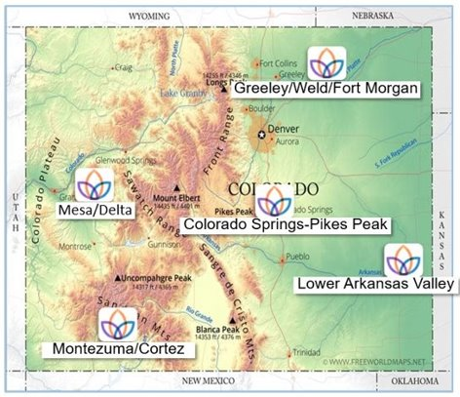
Regions
Notes:
Actual map

Slide 59
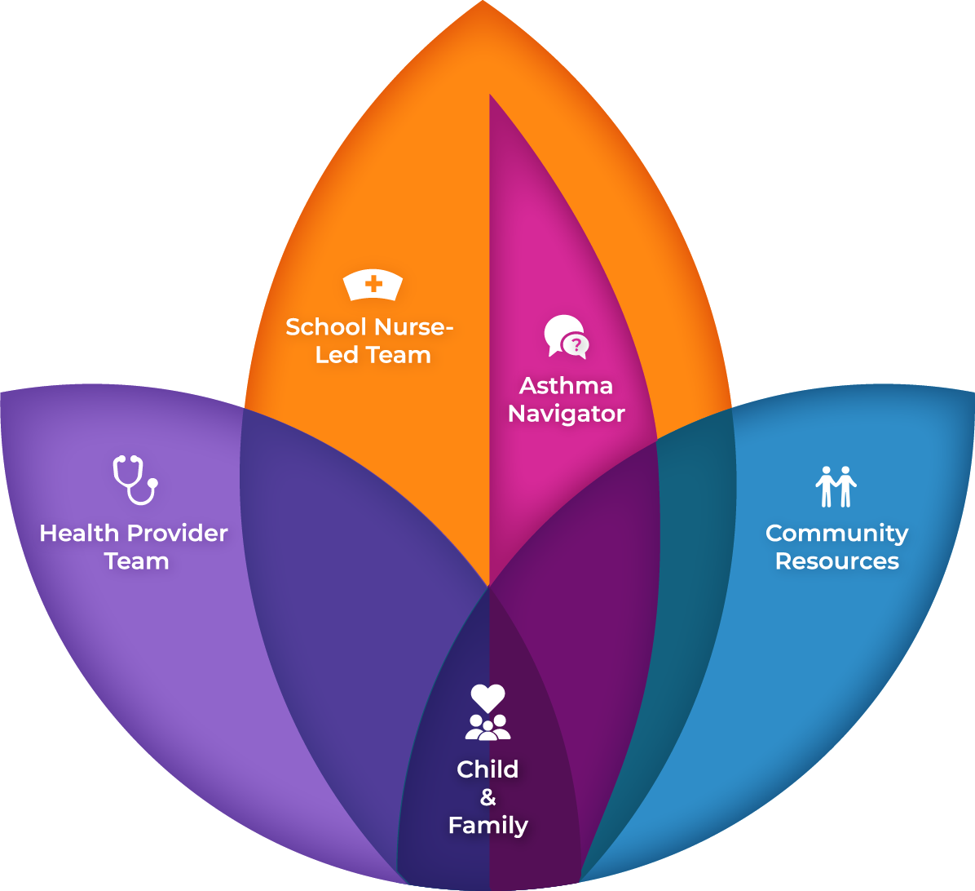

Slide 60
Program Elements
Identify and assess students with asthma and identify risk for future burden (All students with asthma)
Ensure students have access to a quick relief inhaler and CO Asthma Care Plan and Medication Order for Schools and Child Care Settings
Provide asthma education and support asthma self-management skill development for most at-risk
Case management and care coordination for most at-risk
Asthma Navigator to support and assist school nurse with optimizing asthma care and management
asthma education
case management
communication and care coordination with families and health providers
address social determinants of health
Notes:
John's timeline from consent form

Slide 61
Year 1 of BACK study
Year 2 of BACK study
Group 1
Parent meets once with Navigator
Usual asthma care at school
Asked to fill out forms to help us make BACK better
*Start Group 2 activities
*Start Group 3 activities
Group 2
Parent meets with Navigator 3 times
Student meets with Navigator 3 times during school
Asked to fill out forms to help us make BACK better
*Stay in Group 2
Group 3
Parent meets with Navigator 3 times
Student meets with Navigator 3 times during school
Navigator does extra work with school and community to support asthma control
Asked to fill out forms to help us make BACK better
*Stay in Group 3
*If asthma control improves a lot after year 1, your child may no longer qualify for BACK

Slide 62
Asthma Navigator Role
2:00-2:30

Slide 63
Asthma Navigator Role
You will be meeting with families through 3 visits a year and 3 in school visits with students to deliver asthma education and collect data
  Data to understand what has changed with their asthma for program purposes so that you can understand what that family/student needs and how to deliver the program
  Data to deliver to the research team to understand how the program is working overall
These visits involve interviewing families to collect information and educating students and their families about asthma to improve their asthma management skills

Slide 64
Different types of data
You will be working closely with families to help improve the student's asthma AND you will be collecting data for the study
  These are the two different modes you'll be in when meeting with families
Data collection vs. Coaching – we will dive into this more in each of the forms
  When doing data collection, you will need to ask the questions as written and fill them out.
    When you see questions in blue, read as is AND the PROMIS survey
  When doing coaching, you are collecting knowledge from them to help understand how to improve asthma
Notes:
Could we put a asrickss in for questions that need to be asked word for word (italicized word for word questions) or make those questions red

Slide 65
Interviewing Skills- Building Rapport
Why is building rapport important?
  Establishes relationships with families, builds trust, and keeps families engaged with the program
  Parents/Caregivers more likely be open and honest with you
How to build rapport?
  Introduce yourself, warm up the conversation casually, informal check-in
  Active listening
  Share personal 'tidbits' as appropriate and relevant
  Follow up and keep promises

Slide 66
Interviewing Skills- Probing
Probing: Questions that elicit more relevant information that may not be initially offered by a participant
  Tool for Semi-structured interviewing
  Can be pre-identified follow-up questions written by the study team
  Spontaneous probes are unplanned and can be used as needed to get additional depth in responses
Examples:
*Silence*
Why is that?
Can you tell me more about that?
You make an interesting point, how do you think _______ impacts your child's asthma care?

Slide 67
Interviewing Skills
Earlier you mentioned that your child has had four asthma attacks this week, can you tell me more about these flare-ups?
Active Listening
  Non-verbal: nodding, eye-contact
  Verbal: "mmhmm", "uh-huh", "interesting"
Rephrasing/Summarizing
  Shows active listening, helps to build rapport
  Allows you to confirm your understanding of what a participant is saying
  Allows you to explore a point made previously
I want to make sure I understand what you are saying. What I'm hearing is that...

Slide 68
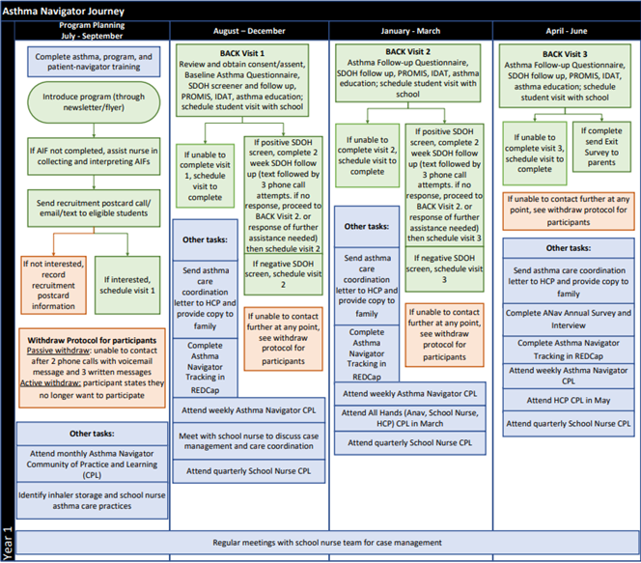
Asthma Navigator Journey

Slide 69
Intervention: Data Collection and RedCap Overview
2:30-3:00
Data collection overview (share timeline)
Tools (walk through and introduce with paper versions)
Notes:
Add interviewing into role play

Slide 70
Timeline
Let’s start by looking at the BACK Timeline to get an understanding of the flow of the year and what is happening when

Slide 71

BACK Timeline
Part 1: Recruitment and Visit 1
July – August
August - December: Visit 1
Attend registration and back-to-school events as available
Help nurse collect Asthma Intake Forms
Assess Asthma Intake forms for eligibility
Recruit eligible students into the program
Schedule visit 1 with family
Complete visit 1 with family
  Consent/assent
  Baseline Navigator Questionnaire
  Social Needs Screener
  Social Needs guided conversation with a 2-week check in
  Asthma education
  Family will be sent post-visit survey to complete
Complete visit 1 with student
  IDAT
  Asthma education
For waitlist schools, complete a family visit with Consent/assent, Waitlist Baseline Navigator Questionnaire and Social Needs Screener

Slide 72
BACK Timeline
Part 2: Visit 2 and 3
January - March: Visit 2
March - May: Visit 3
Schedule visit 2 with family
Family will be sent pre-visit survey to complete
Complete visit 2 with family
  Post baseline demographics survey and pre-visit survey if they did not complete them on their own
  Follow-up Navigator Questionnaire
  SDOH Follow up
  Asthma education
Complete visit 2 with student
  IDAT
  Asthma education
Schedule visit 3 with family
Family will be sent pre-visit survey to complete
Complete visit 3 with family
  Pre-visit survey if they did not complete it on their own
  Follow-up Navigator Questionnaire
  SDOH Follow up
  Asthma education
Complete visit 3 with student
  IDAT
  Asthma education

Slide 73
BACK Timeline
Part 3: End of the school year and summer
May – June
June – July
Family will be sent annual survey to complete
ANs will be sent annual survey to complete
Confirm school nurse participation in BACK next year
Find out about any planned registrations or back to school events for next school year
Find out about any planned registrations or back to school events for next school year
Complete further training and professional development
Prepare for upcoming school year

Slide 74
Database Overview
You will be working in 4 different databases
  DECIPHeR - Schools
  DECIPHeR – Students, longitudinal
  DECIPHeR – Clinics
  DECIPHeR – Regional
Notes:
Show database in real time
Add screenshots to help them login to RedCap and click into the different databases
DECIPHeR - Schools: where you will record school information
DECIPHeR – Students, longitudinal: where you will record student information
DECIPHeR – Clinics: where you will go to record and find clinic information
DECIPHeR – Regional: where you will record SDOH agency communications and take your annual assessment of the program

Slide 75
Database Overview
You will be using these databases for several types of activities
  Tracking
    Visits scheduling
    Dates/communications with families, nurses, clinics, and SDOH organizations
  Recording data
  Pulling reports
  Completing surveys
Notes:
Collecting data as a help for you to provide education/counseling/coaching
Data collection for outcomes/research
Recording data
Data collection during student and family visits
Collecting data from you as well as a data participant
Pulling reports: help you organize your workload and an easy way to stay on track with all the families you are working with
Completing surveys: You will have 2 annual surveys

Slide 76
Types of Data Collection
  Collecting data as a help for you to provide education/counseling/coaching
  Data collection for outcomes/research
  Collecting data from you as a data participant

Slide 77
School Database
School Information: baseball card level information
Beginning of the School Year Tracking: where you will record project introduction and student recruitment activities you will be doing with the school nurse (like collecting Asthma Intake Forms and assessing for program eligibility)
School Wide Communications Tracking: separated by groups
School Nurse Team Meetings Tracking: where you will track your meetings with school nursing teams
ANav Annual Survey: each year, you will fill out surveys for several schools you work with (schools specified by study team)

Slide 78
Clinics Database
This database will primarily be used for finding information (pulling reports) about clinics that your students are getting asthma care through. Each clinic has a liaison that has agreed to work closer with the BACK team to solve any asthma related issues
If you connect with a clinic that is not already on our list, you can record it in this database

Slide 79
Regional Database
SDOH Contacts: Recording general interactions with SDOH agencies (other than referring families)
ANav Annual Program Assessment: You will take this once a year to give feedback on the program. The study team will likely be using this feedback to make improvements to the program

Slide 80
Student Database
This will be your most used database
It contains forms to aid you in the student recruitment process, scheduling visits, and guiding you through visit activities
There are 24 forms and surveys in total
Student Recruitment
Visit 1: Visit 1 Scheduling Log, Consent, Visit 1 Log, Intervention Baseline Navigator Questionnaire, IDAT Assessment, SDOH Screener, SDOH Conversation, Post-Baseline Demographics
Visit 2: Visit 2 Scheduling Log, Pre-Visit 2 Survey, Visit 2 Log, Follow-up Navigator Questionnaire, SDOH Follow-up V2
Visit 3: Visit 3 Scheduling Log, Pre-Visit 3 Survey, Visit 3 Log, Follow-up Navigator Questionnaire, SDOH Follow-up V3
Other: Active Withdraw, Rescheduling Log, DC Scheduling Log

Slide 81
Break
3:30-3:45

Slide 82
Social Determinants of Health
3:45-5:15
Overview of Social Determinants of Health (20 mins)
SDOH management and processes for BACK (30 mins)
Role Play SDOH conversation (40 mins)

Slide 83
Objectives
• To review social determinants of health (SDOH) and how they influence health and healthcare
• To summarize how SDOH influence asthma care and outcomes
• To describe the process of SDOH screening and intervention in BACK
To practice SDOH screening and referral conversations

Slide 84
SDOH and Health Inequities
Social determinants of health (SDOH): the non-medical factors that influence health outcomes. They are the conditions in which people are born, grow, work, live, and age, and the wider set of forces and systems shaping the conditions of daily life.
Social inequities in health: the unfair and avoidable differences in health status across groups in society that result from the uneven distribution of social determinants
Notes:
.

Slide 85
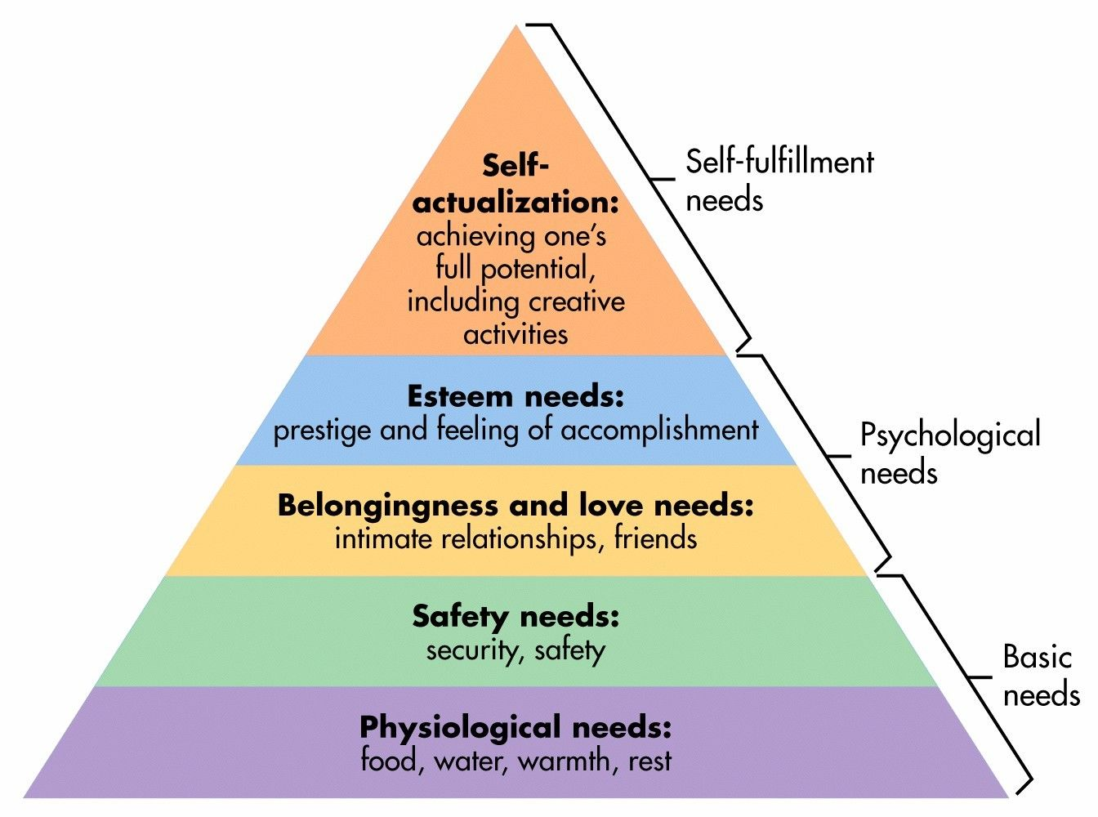
Maslow’s Hierarchy of Needs
Notes:
Speaking of basic needs, lets review Maslow’s theory of the hierarchy of needs. We Know that until our students basic needs are being met they cannot advance on to psychological or self fulfillment needs
Click
If we think about this with an asthma and educational mindset, our students with asthma cannot access their education and achieve complete success until their basic needs are met, such as access to healthcare, medication, and a safe and healthy environment (including good or better air quality). Remember… it is about the individual student, right? Every student may need something different. We must start at the bottom (or the base of this pyramid) and work our way up in order for our students to be successful, access their education and achieve health.

Slide 86
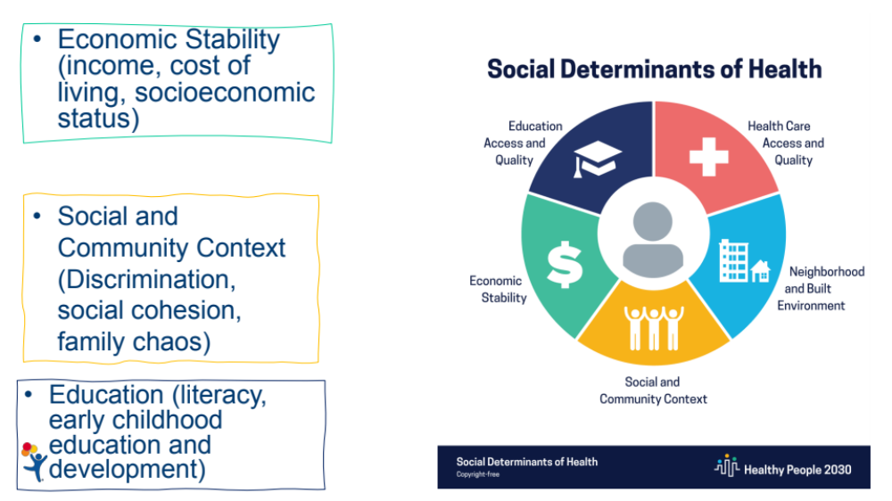
Notes:
One of Healthy People 2030’s 5 overarching goals is specifically related to SDOH: “Create social, physical, and economic environments that promote attaining the full potential for health and well-being for all.”

Slide 87
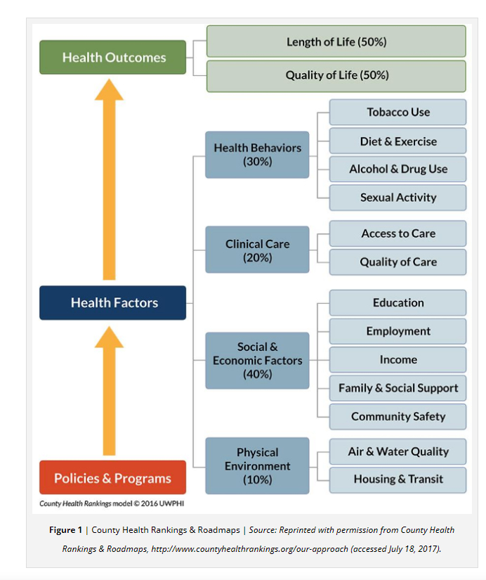
National Academy of Medicine Social Determinants of Health 101 for Health care: Five Plus Five
https://nam.edu/social-determinants-of-health-101-for-health-care-five-plus-five/

Slide 88
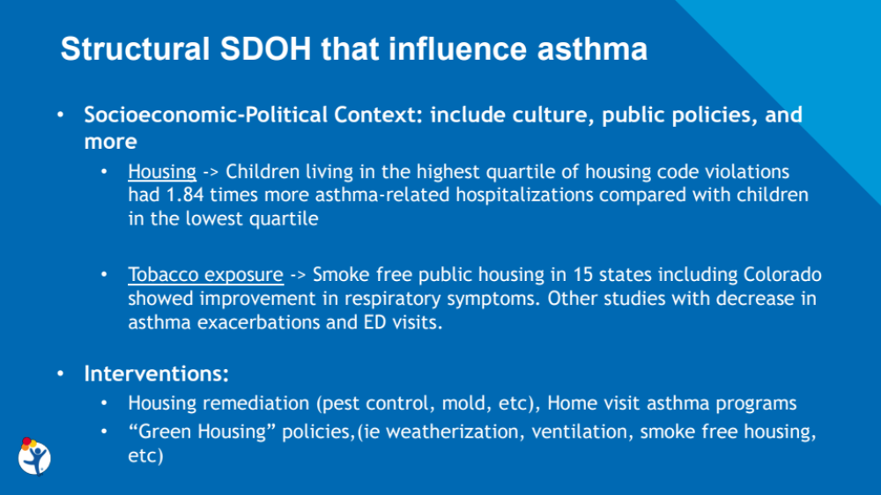

Slide 89
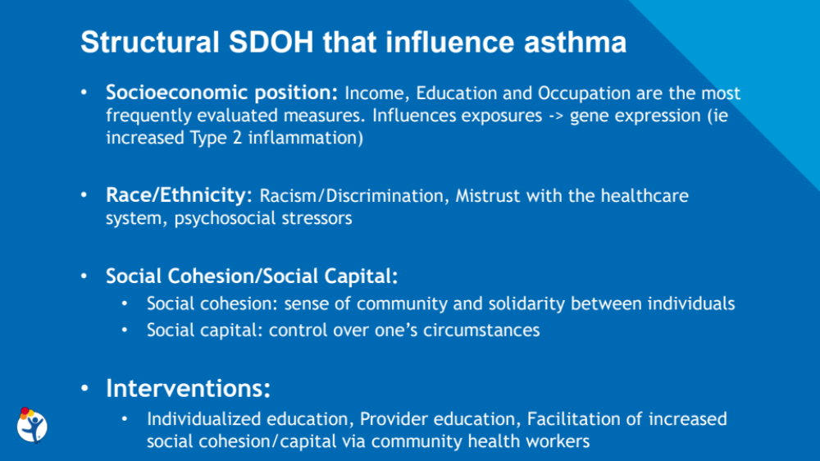

Slide 90
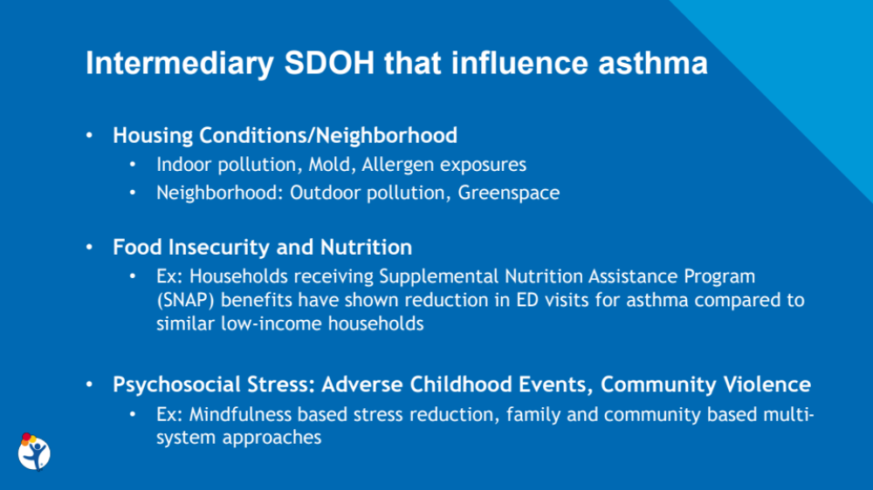

Slide 91
Interventions to Consider Following SDOH Screening
Referral for resources based on availability of those resources.
Motivational interviewing to encourage adherence to the management plan in the face of competing demands
Adjusting the management plan based on family capacity
Policy changes to address major systematic issues for patients served by the health care system.

Slide 92
SDOH Management in BACK
Addressing social determinants of health with families is built into your visits.
  SDOH Screener: completed during visit 1
  SDOH Conversation: you will facilitate a conversation based on the families responses to the screener. You have a conversation guide to help guide you as well as a form in the Student Database to record the conversation
  SDOH 2-week Check Ins: If resources are provided to the family, you will follow up with them 2 weeks after the visit to check in
  SDOH Follow up: In visits 2 and 3 you will follow up with the family to check in on any resources provided and see if new needs have arisen
  The BACK Resource Guide outlines the resources in your area that can help families address their needs. The SDOH 1-pager will be given to every family and highlights the top resources in the area

Slide 93
SDOH Support in BACK
Families will fill out our social determinants of health screener at their first visit
You will review the screener and facilitate a conversation surrounding their social needs to identify what resources, if any, they would like to be connected to and what hesitations, if any, they have that may hold them back
The screener is divided into different domains that have been found to affect asthma
Any questions about the screener?

Slide 94
BACK Social Needs Screener
Screener Development Process
  Modified Delphi process to identify appropriate and priority domains for SDOH screening I
  Literature review to identify validated items for inclusion and determine an appropriate tool layout for populations with limited health/general literacy.
    Layout was adapted from the Boston Medical THRIVE screening tool to include graphic cues for each domain.
  Presentation of a screening tool draft at community advisory board meetings for refinement
  Pilot in a community health center to get patient feedback to aid further refinement.
Pilot Findings
  Most families understood the purpose of the tool, felt questions were clear, appropriate, and quick to complete, and liked the pictures.
  Some concerns about families’ willingness to disclose needs.
  Recommendation to add a statement assuring confidentiality to encourage honest reporting
Any questions about the screener?

Slide 95
SDOH Conversation Guide
Let’s walk through the SDOH Conversation Guide together
Even if families don’t indicate any needs on their screener, there are still some questions to ask
You will help families prioritize their TOP 2 SDOH needs if they have indicated 3 or more needs

Slide 96
SDOH 2-week Check In
The information about the 2-week check in is in the Visit 1 (and 2) Logs
You will send a text to confirm that the resources you provided were helpful 2 weeks after resources were provided during visit 1 or 2
  New resources will not be provided in visit 3 so there will not be a need to do a 2-week check in
If you don’t hear back, you will assume that it went well
If you hear back that they are having difficulties, you will connect with them to help troubleshoot

Slide 97
SDOH Follow Up V2 and V3
During visits 2 and 3 you will follow up with families to find out more about connecting with the resources you provided and asking about any new needs that might have emerged
Let’s walk through the SDOH Follow up Form together

Slide 98
Resource Guide
Our team created a resource guide in collaboration with our Community Advisory Boards, Trailhead Regional Health Connectors, and other community members
This is meant for you to use when a family indicated an unmet need. Every family also receives a shorter “1 page” version for their region
There is a tab covering statewide resources as well as a tab for each region
This is meant to be a living document. If you notice something is wrong and needs to be changed, please let us know to update it
Take some time to review the document and ask any questions!

Slide 99
Let’s Practice!
Everyone pair up – you have each been provided 2 completed SDOH screeners. Each of you take a turn guiding a conversation based on how the screener was filled out
Save your screeners and SDOH conversation forms to practice entering into REDCap over the next two days
Notes:
What are you worried most about with having these conversations?
What do you feel confident about?
What other things may be helpful?

Slide 100
Scenario 1
The family switched employer insurance recently to a lower cost plan and their insurance is not paying for the prescribed controller medication
Child is on insurance through their employer but finances are tight and they're wondering if they should look into public health insurance for their child (Medicid/CHP+)

Slide 101
Scenario 2
This child is on Medicaid and family is happy with their coverage and they have had no problem with non-coverage of prescribed asthma medications
The family has been trying to reapply for SNAP but it has now been 2 months and they haven't heard anything about their application
They have lots of other concerns that may be affecting the child's asthma
In this scenario, you will need to help them prioritize their concerns and support the caregiver with their sense of overwhelm

